Slide 1
Famous people
Daniel Slanina
Kirill Radchenko
2.B

Slide 2
Marián Hossa
Slovak professional ice hockey right winger
currently playing for the Chicago Blackhawks of the National Hockey League (NHL)
he was drafted by the Ottawa Senators in the first round, 12th overall, of the 1997 NHL Entry Draft
Notes:
Left handed

Slide 3
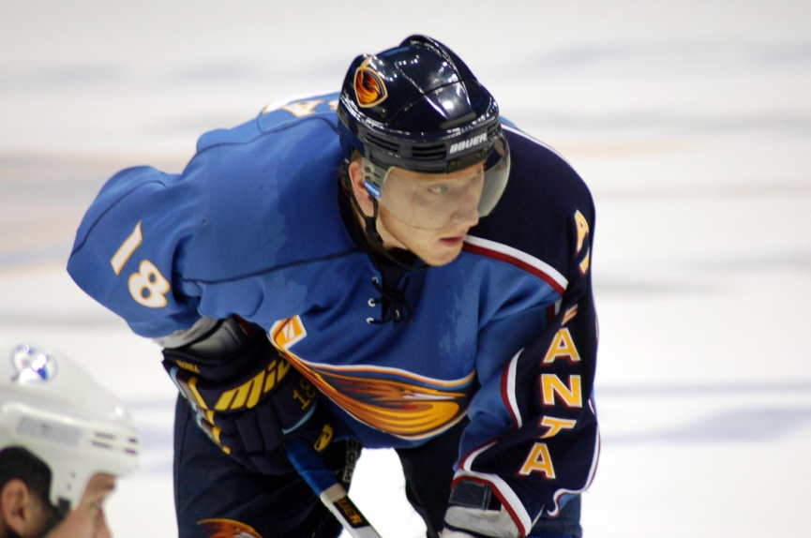
His life
Born on January 12, 1979 in Stará Ľubovňa
he was drafted by the Ottawa Senators in the first round, 12th overall, of the 1997 NHL Entry Draft
played for the Atlanta Thrashers, Pittsburgh Penguins, Detroit Red Wings and his current team, the Chicago Blackhawks

Slide 4
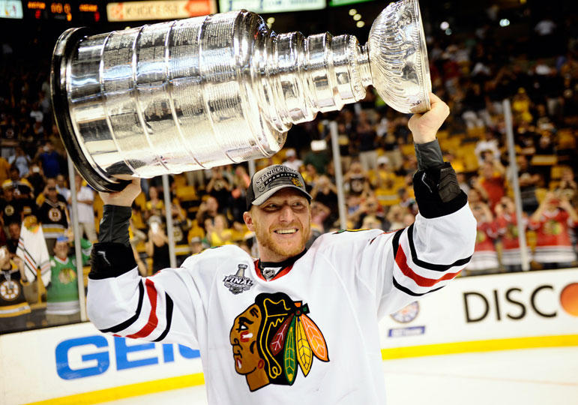
Interesting facts
played in three consecutive Stanley Cup Finals with three different teams, finally winning the Stanley Cup in 2010 with Chicago Blackhawks
In 2013 he won his second Stanley Cup and third in 2015

Slide 5
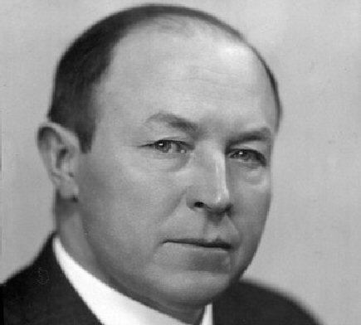
Martin Benka
was a Slovak painter and illustrator
he is regarded as the founder of Modernist 20th century Slovak painting.

Slide 6
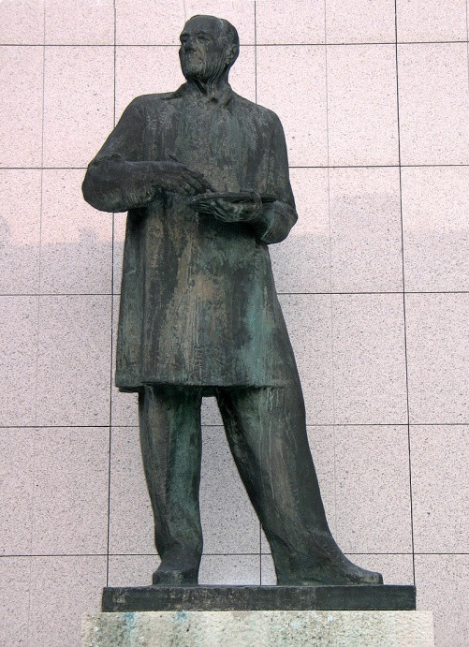
His life
Born on 21 September 1888 in Kostolište
Died on 28 June 1971 in Malacky
He is buried in the National Cemetery in Martin
Notes:
Statue in Bratislava

Slide 7
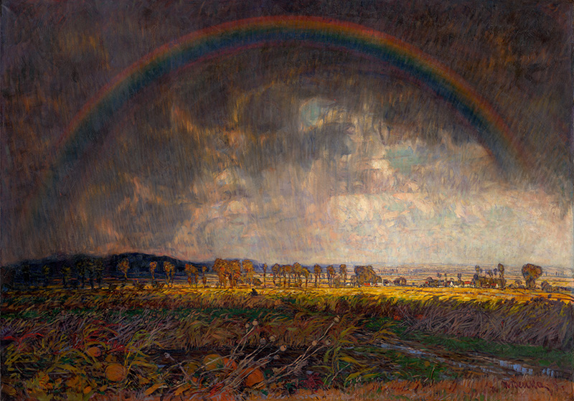
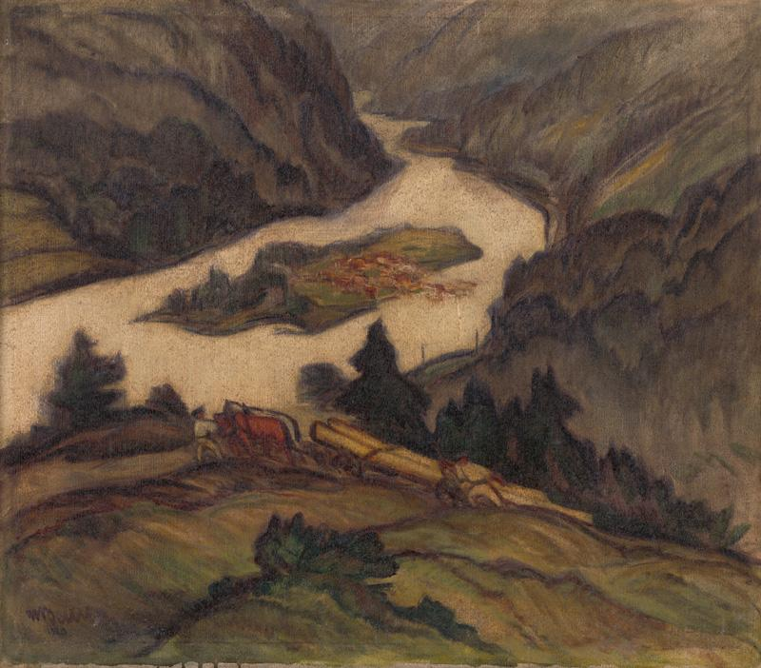
Interesting facts
along with Ľudovít Fulla, Mikuláš Galanda, and the Czech Jaroslav Vodrážka, he created Modernist Slovak typography
he was a prolific creator of different fonts
Notes:
Na rieke Orava, po búrke

Slide 8
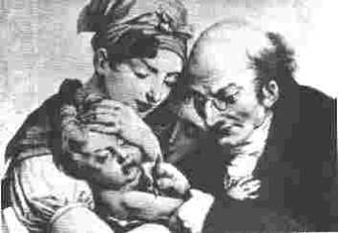
Ján Adam Rayman
he was a doctor, infectionist, immunologist and pharmacist
he graduated in pharmacy at Prešov Evangelical college
first vaccination against smallpox - 1721

Slide 9
His life
he was born on April 23, 1690 in Prešov
he died on April 23,1770 in Prešov
his dad was druggist, it affected him in his career choices

Slide 10
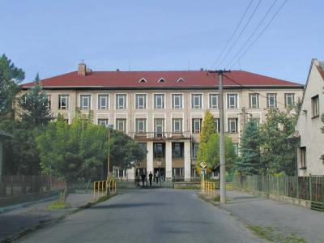
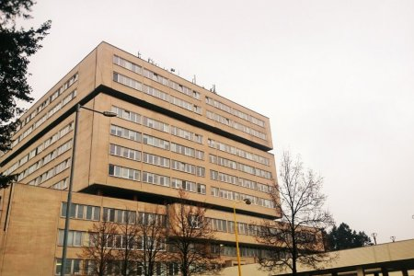
Interesting facts
in 1714 he married Žofia Wachsmannová with whom, later, he had 7 children
he was a municipal doctor in Prešov
Reimanova Street in Prešov University Hospital J.A. Raymana, Grammar school J. A. Raymana and private health clinic Reimanus have his name

