Slide 1
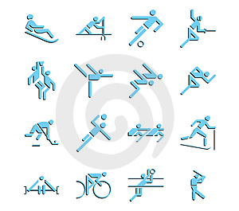
SPORT MILLIONAIRE
Questions

Slide 2
OLYMPICS

Slide 3
1. Why are the Games called “the Olympics”?
invented by Greek athlete Olympus
first winner was from the Olymp village
C. started in Olympia, Greece.
D. started in Olymp village, Greece

Slide 4
2. What was Olympia?
a big mountain in Greece
an ancient Greek town
C: a birth place of Zeus
D. an ancient sport centre

Slide 5
3. What do the five Olympic rings that appear on the flag signify?
strength
B. union of the five powerful countries
C. union of the five continents
D. five basic qualities of a sportsman

Slide 6
4. When were the first Olympics?
566 BC
677 BC
776 BC
566 AD

Slide 7
5. When and where were the first modern Olympic games held?
Athens in 1896
Athens in 1986
C. Athens in 1906
D. Rome in 1898

Slide 8
6. What was the first Olympic event?
jumping
the sprint
C. wrestling
D. discus

Slide 9
7. How many types of Olypmpics are there?
2
3
C. 5
D. 4

Slide 10
8. When did women start competing?
1912
1906
C. 1945
D. 1952

Slide 11
9. What does the Olympics motto “Citius, altius, fortius” mean?
“Faster, longer, stronger”
“Faster, better, stronger”
“Faster, higher, better”
“Faster, higher, stronger”

Slide 12
10. Can athletes under seventeen participate in the Olympics?
Yes
No
C. In some sports no

Slide 13
11. How many sports and events are in the Olympics?
22 sports/ 254 events
30 sports /301 events
C. 28 sports /301 events
D. 15 sports/201 events

Slide 14
12. Has China ever hosted the Olympics?
Yes
No
C. It will in 2012
D. Never will because of regime

Slide 15
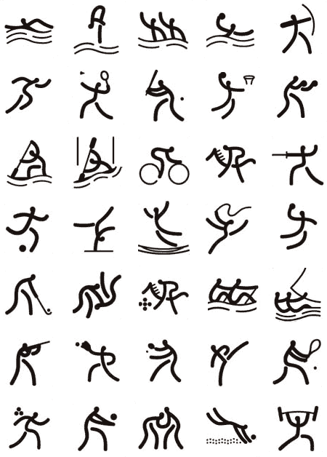
S
P
O
R
T

Slide 16
In what country was football invented?
England
Brazil
C. China
D. Italy

Slide 17
2. Which country has won the most Football World Cups?
Brazil
Italy
C. Germany
D. Argentina

Slide 18
3. What is the fastest women´s serve Tennis) ?
114 km/h
210 km/h
C. 119 km/h
D. 206 km/h

Slide 19
4. Slovakia takes part at every World Championship in ice-hockey since ...(year?)
1993
1999
C. 1996
D. 2000

Slide 20
5. Slovak ice-hockey team won gold medal in .................... .
2000
2003
C. 2005
D. 2002

Slide 21
6. On hockey jerseys what does the 'A' stand for?
alternate coach
alternate player
C. alternate captain
D. alternate goalkeeper

Slide 22
7. Who has scored the most goals in the history of the NHL?
Wayne Gretzky
Steve Yzerman
C. Jaromír Jágr
D. Mario Lemieux

Slide 23
8. What's the oldest stroke used in competitive swimming?
the butterfly
the breastroke
C. the backstroke
D. the crawl

Slide 24
9. What is Moscow's most famous football club?
Dynamo Moscow
Spartak Moscow
C. Torpedo Moscow
D. Locomotive Moscow

Slide 25
10. Which piece of sporting equipment is 3 inches in diameter and weighs 6 ounces?
an ice hockey puck
a tennis ball
C. a baseball ball
D. a billiard ball

Slide 26
11. Sergey Bubka broke the world record 32 times at which sport?
javelin throw
long jump
C. pole vault
D. high jump

Slide 27
12. Which game is sometimes described as 'bowls on ice'?
figure skating
curling
C. speed skating
D. ice-hockey

Slide 28
13. How many events make up the heptathlon?
Six
Five
C. Four
D. Seven

Slide 29
14. In which sport do you play for the Stanley cup?
Baseball
Floor ball
C. Ice Hockey
D. Football

Slide 30
15. Which African country were the first to reach the world cup quarterfinals?
Cameroon
Nigeria
C. Senegal
D. Egypt

Slide 31
16. Which sport in Slovakia has been the most successful so far at the Olympics ?
shooting
canoeing
C. swimming
D. biathlon

Slide 32
17. Which country has won the most medals in the Winter Olympics so far (to January 2010)?
the USA
Norway
C. Canada
D. Switzerland

Slide 33
18. Which footballer scored in the 1958 World Cup Final when only 17 years old?
Pele
Maradona
C. Ronaldo
D. Ronaldino

Slide 34
19. What sport has the fastest speed achieved without mechanical assistance?
ice hockey
downhill skiing
C. skeleton
D. sledging

Slide 35
20. How many players or swimmers are there in a water polo team?
11
6
C. 9
D. 7

Slide 36
21. Which sport or game consists of clubs, balls, hits, bunker?
rugby
cricket
C. golf
D. badminton

Slide 37
22.The abbreviation SLO in the inernational sports abbreviations of countries stands for ....
Slovakia
Somalia
C: Slovenia
D. Sierra Leone

Slide 38
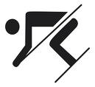
23. We don´t need when skiing .....
ski poles
slope
C. ski tow
D. shuttlecock

Slide 39
24. Which game would you associate the names of Marek Matiaško, Miroslav Matiaško. Janka Gereková, Martina Halinárová with?
swimming
skiing
C. snowboarding
D. biathlon

Slide 40
25. What do American cheerleaders usually hold in each hand for their routines at sport events?
Loudhailers
B. Model flags
C. Pompoms
D. Drumsticks

