Slide 1
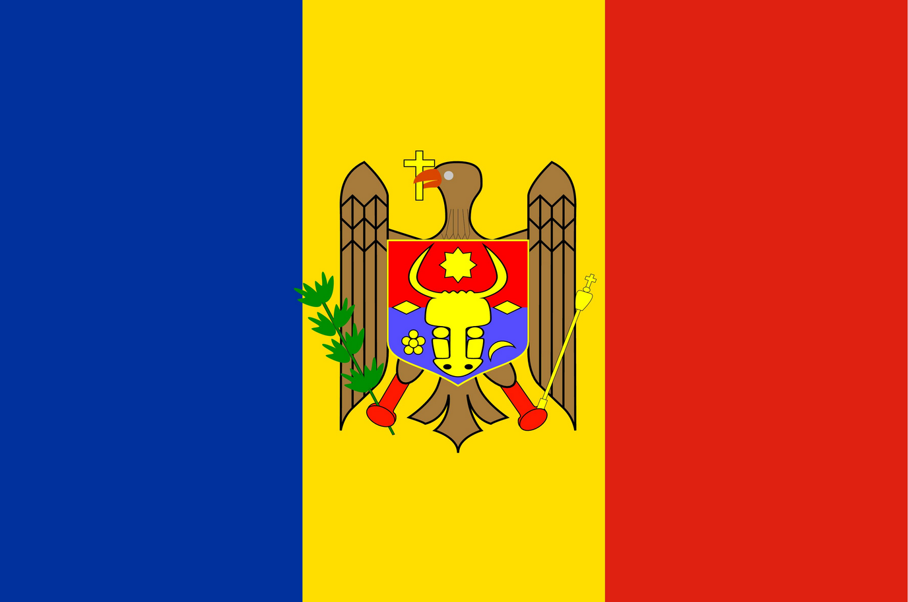
Moldavsko
Matej Babej 3.a

Slide 8
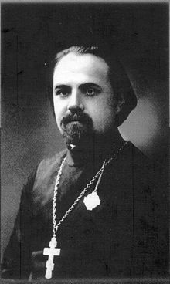
Limba noastră (Náš jazyk)
https://www.youtube.com/watch?v=OsRKXJh-lYo

Slide 9
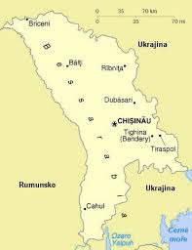
Židovský cintorín

Slide 10
Železničná stanica v Kišiňove

Slide 11
Pevnosť Tighina (Bender)

Slide 12
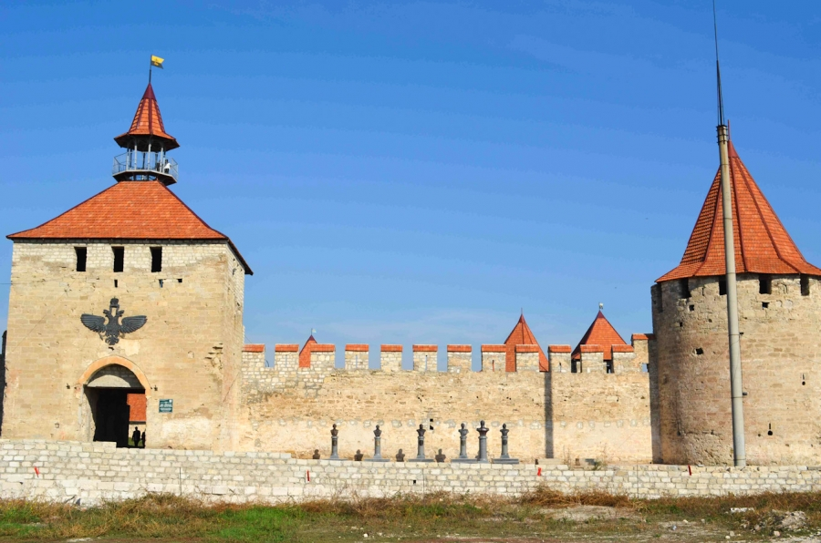
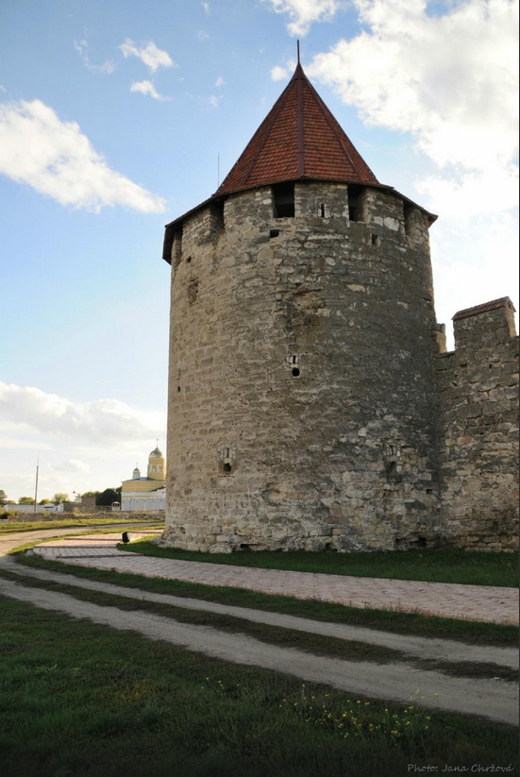

Slide 13
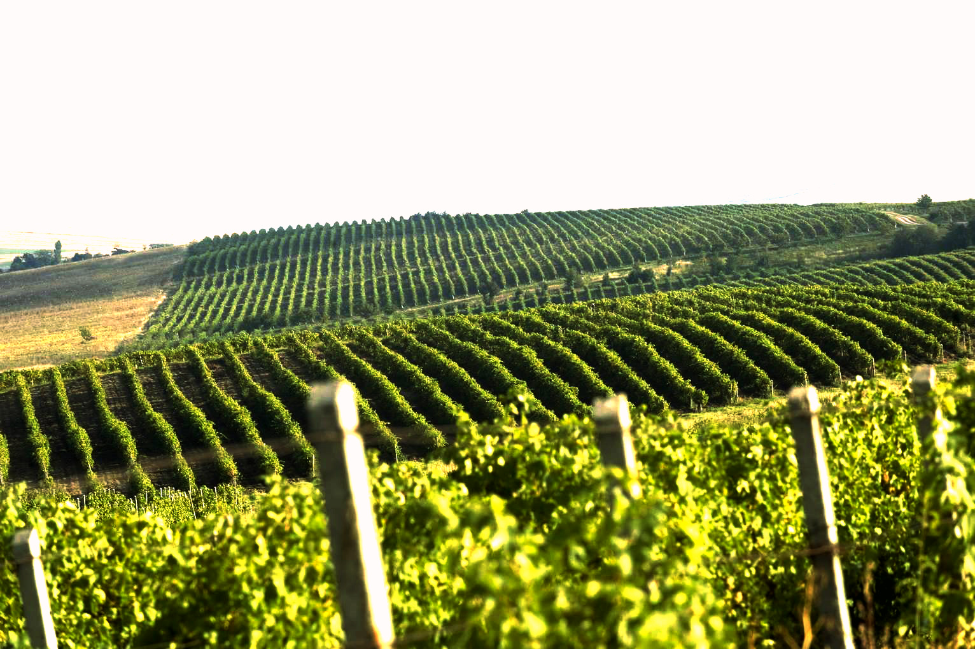

Slide 15
Milestii Mici

Slide 16
Vináreň Milestii Mici

Slide 19
Cricova (vinărie)

Slide 20
Cricova (vinărie) vináreň

Slide 22
https://www.youtube.com/watch?v=UeH4XDMbjzI

Slide 25
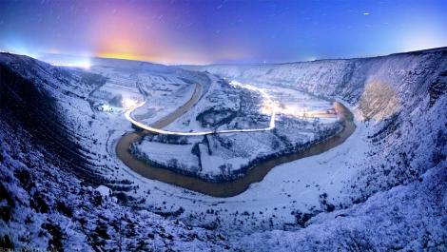
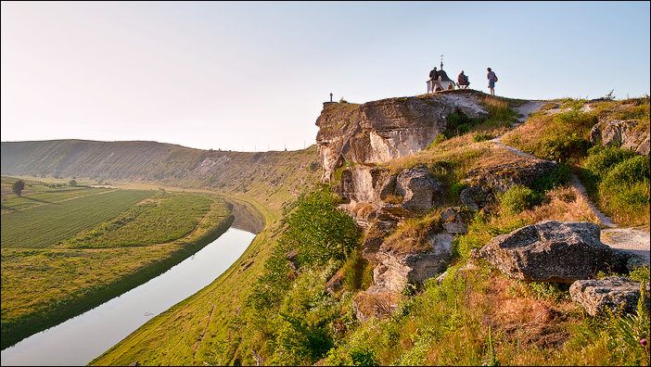
Orheiul Vechi

Slide 26
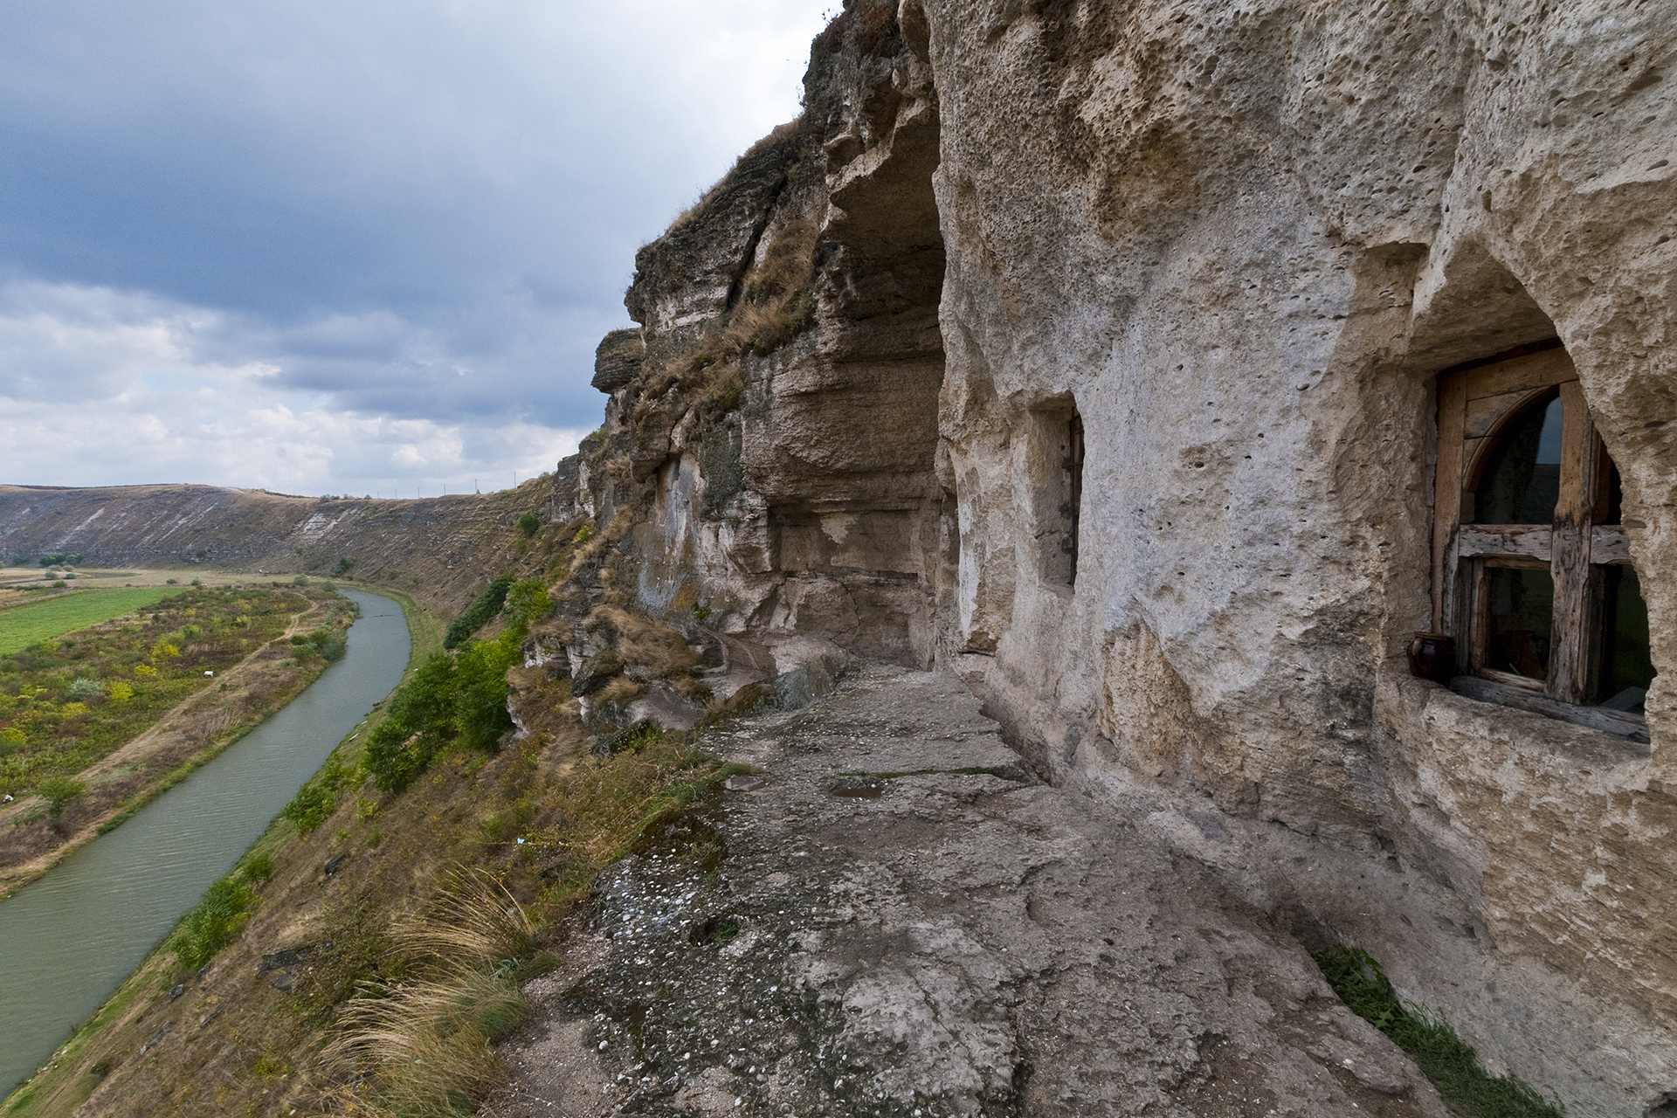

Slide 27
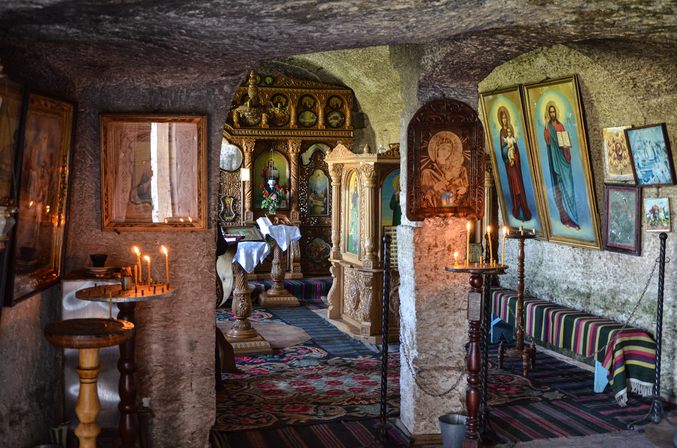

Slide 28
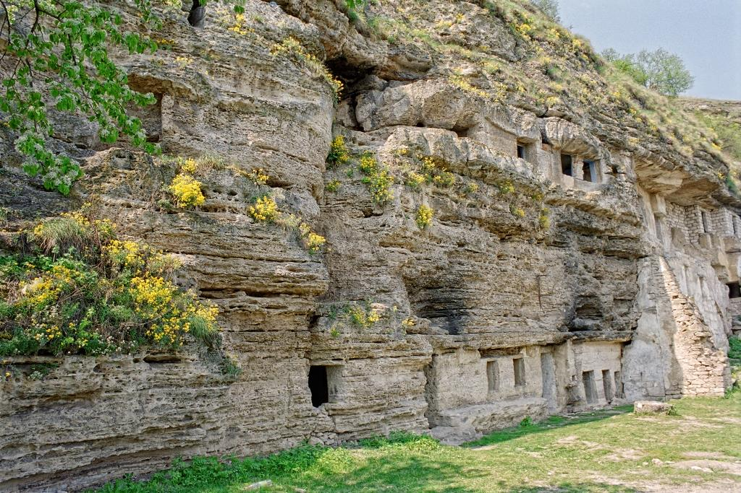
Tipova

Slide 30
Pevnosť Soroca

Slide 32
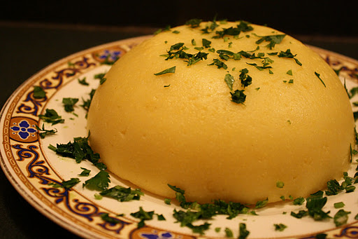
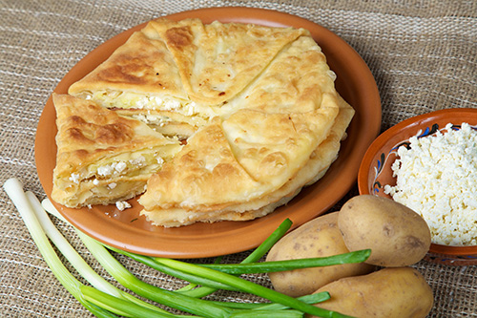
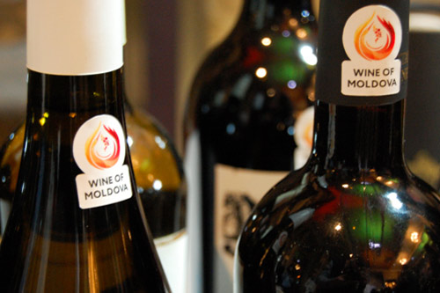
Jedlá
Mamaliga
Sarmale
Palacite

Slide 33
Bielorusko

Slide 34
https://www.youtube.com/watch?v=srfhJG_yVqY

Slide 35
Нясвіжскі палац / Zámok v Ňasviži

Slide 38
Музей ВАВ
Múzeum VAV

Slide 41
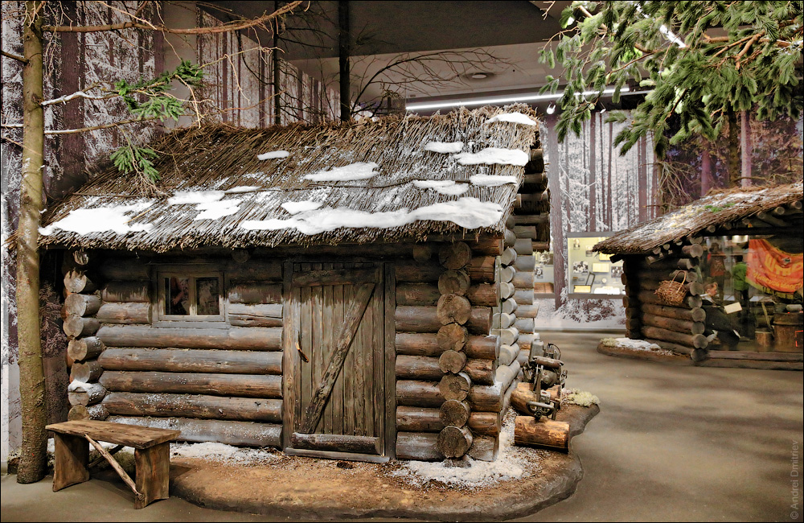

Slide 44
Palác Puslovských v Kossove / Kossovský hrad

Slide 45
Palác Puslovských v Kossove / Kossovský hrad

Slide 46
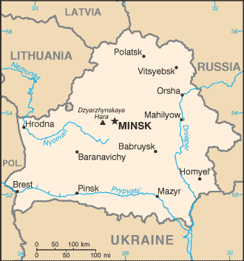
Národný park Belovezhskaya Pushcha

Slide 47
Divadlo opery a baletu Bieloruska

Slide 48
Bieloruská národná knižnica

Slide 50
Ulica Nezávislosti

Slide 51
Tyodor Machnov

Slide 52
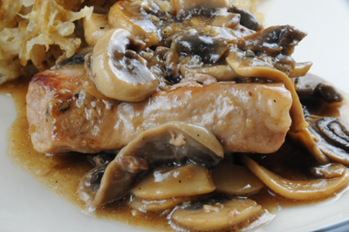
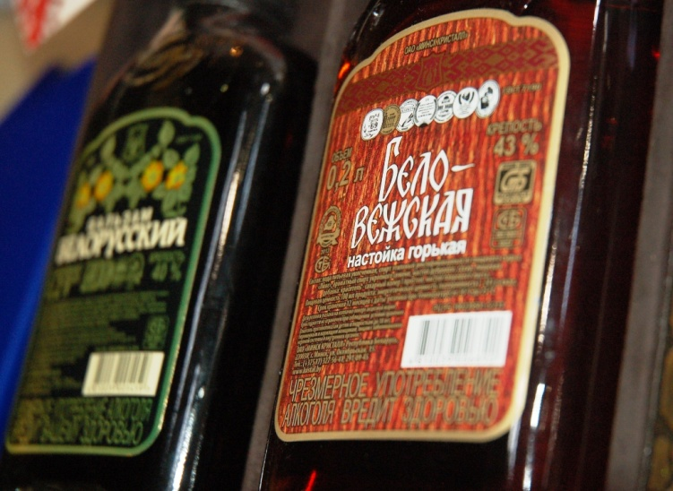
Jedlá
Mazurek
Draniki
Kotleta pokrestyansky

Slide 53
Zdroje
https://www.youtube.com/watch?v=OsRKXJh-lYo
https://en.wikipedia.org/wiki/Limba_noastr%C4%83
http://wikitravel.org/en/Moldova
http://www.gazprom.com/press/news/2012/march/article132294/
http://www.crwflags.com/fotw/flags/md.html
http://www.konzervativnyvyber.sk/desiatky-tisic-ludi-v-moldavsku-ziadali-pripojenie-k-rumunsku/6740/
https://www.youtube.com/watch?v=UeH4XDMbjzI
https://www.youtube.com/watch?v=MvVTUAgysnM
https://triptomoldova.wordpress.com/page/32/ TOTO
http://www.360cities.net/image/kishinev-interior-of-the-cathedral-nasterea-domnului-moldova
http://www.360cities.net/image/near-furceni-reut-river-orhei-moldova-2010-06-20-panorama-2
http://www.360cities.net/image/railway-station-night-2010-07-kishinev-moldova-chisinau-moldova
http://www.atlasobscura.com/places/chisinau-state-circus
http://www.atlasobscura.com/places/chisinau-jewish-cemetery CINTIR
http://www.moldovaholiday.travel/index.php?option=com_k2&view=item&id=17:tighina-bender-fortress&Itemid=39&lang=en Pevnosť
http://www.prospect.md/en/history/monuments/monument-to-the-famous-she-wolf-lupa-capitolina-7425.html Romulus a Remus
http://www.moldovaholiday.travel/index.php?option=com_k2&view=item&id=87:emil-racovita-cave&Itemid=33&lang=en Jaskyňa
http://blackseatourism.net/new/discovering-the-history-of-moldova/#prettyPhoto
http://mynativebelarus.blogspot.sk/search/label/Belarus
http://www.visitcapitalcity.com/europe/Minsk-Belarus
http://www.ekskursii.biz/?place=2884_Kossovo_Castle
http://insidebelarus.com/gallery/castle_in_kossovo#ad-image-1
http://www.belarus.by/en/travel/belarus-life/kossovo-palace
http://nn.by/?c=ar&i=109574
https://www.youtube.com/watch?v=srfhJG_yVqY Hymna
http://www.md4ever.com/about/aboutmoldova/traditions.html
https://twitter.com/worldexpo_md/status/608239340075024384?nav=true
http://www.traveladventures.org/continents/europe/orheiul-vechi08.html
https://www.google.sk/webhp?ie=utf-8&oe=utf-8&gws_rd=cr&ei=QBU9VtW0MYn8swH9-quACQ#q=Cototea+soroca
https://www.google.sk/maps/place/Moldavsko/@47.3020029,28.9705127,3a,75y,264.88h,71.87t/data=!3m8!1e1!3m6!1s-3SFZxN5GJhQ%2FVWbWYPZInCI%2FAAAAAAAAFpM%2FnnRly_ccrQE!2e4!3e11!6s%2F%2Flh6.googleusercontent.com%2F-3SFZxN5GJhQ%2FVWbWYPZInCI%2FAAAAAAAAFpM%2FnnRly_ccrQE%2Fw243-h100-n-k-no%2F!7i2766!8i1137!4m2!3m1!1s0x40c97c3628b769a1:0x258119acdf53accb!6m1!1e1
http://www.panoramio.com/photo/11877883
http://www.panoramio.com/photo/11876956
https://en.wikipedia.org/wiki/Moldova#/media/File:Orhei_Vechi,_Moldova_-_Flickr_-_Dave_Proffer_%2813%29.jpg
http://www.moldovenii.md/en/section/360
https://www.youtube.com/watch?v=uTbfh-U9DcU
http://www.lonelyplanet.com/moldova/things-to-do/top-things-to-do-in-moldova
http://www.milestii-mici.md/en/our-cellars
http://www.vatraneamului.ro/restaurant/interior.html
http://diez.md/2013/07/10/primul-parc-national-din-moldova-va-fi-la-orhei/
http://whc.unesco.org/en/list/1187
http://romaniaandmoldova.com/moldova/
http://www.moldavie.fr/spip.php?rubrique3&debut_articles2=5#pagination_articles2
https://www.cia.gov/library/publications/the-world-factbook/geos/md.html
http://www.factsking.com/countries/belarus/

Slide 54
Ďakujem za pozornosť

