Slide 1
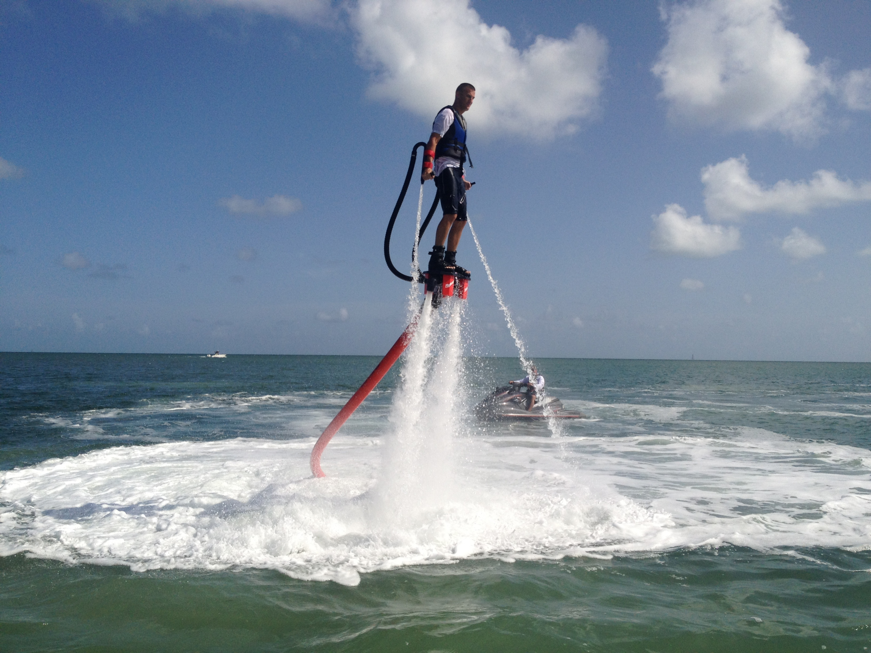
Flyboarding
Matej Pošefko 2.D

Slide 2
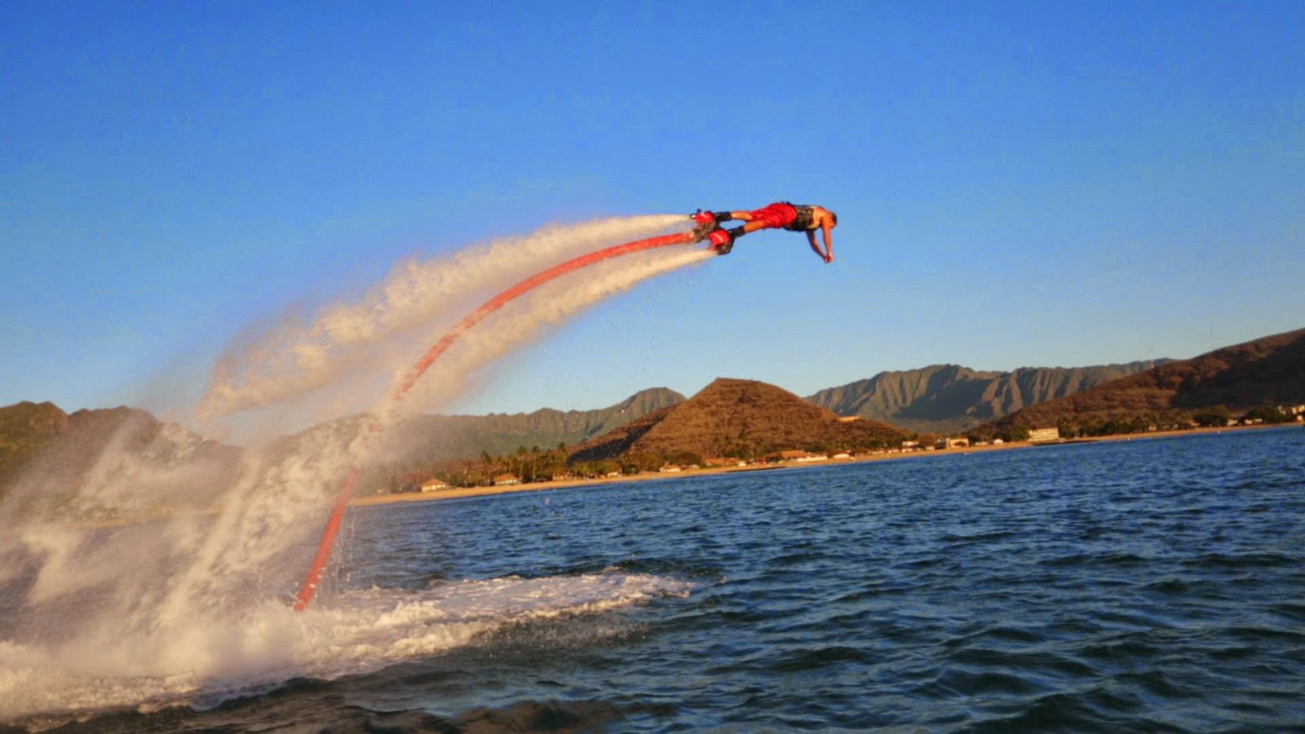
Flyboard
type of water jetpack attached to a personal watercraft, which supplies propulsion to drive the flyboard
A flyboard rider stands on a board connected by a long hose to a watercraft

Slide 3
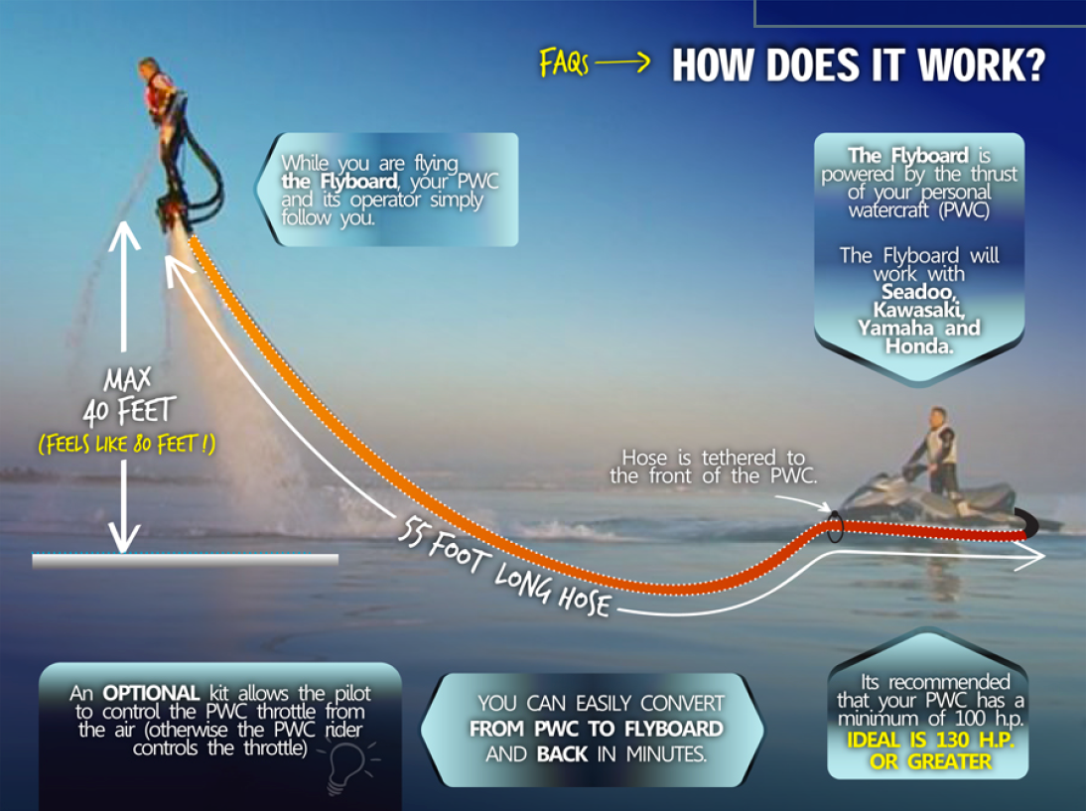
water is forced under pressure to a pair of boots
the flyboard was invented in autumn 2012 by a French water-craft rider, Franky Zapata

Slide 4
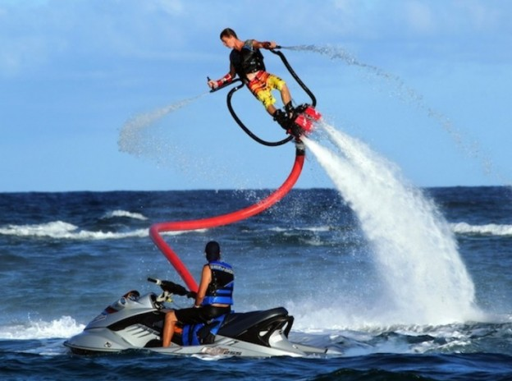
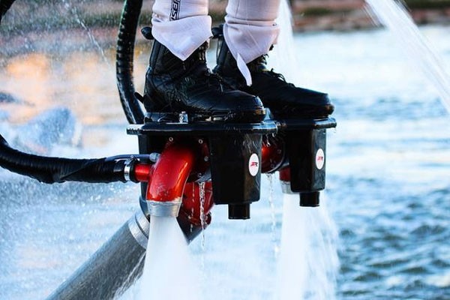
the first flyboard World Championships took place in Dauhá, Qatar in October 2012

Slide 5
Thank you for your attention !

