Slide 1
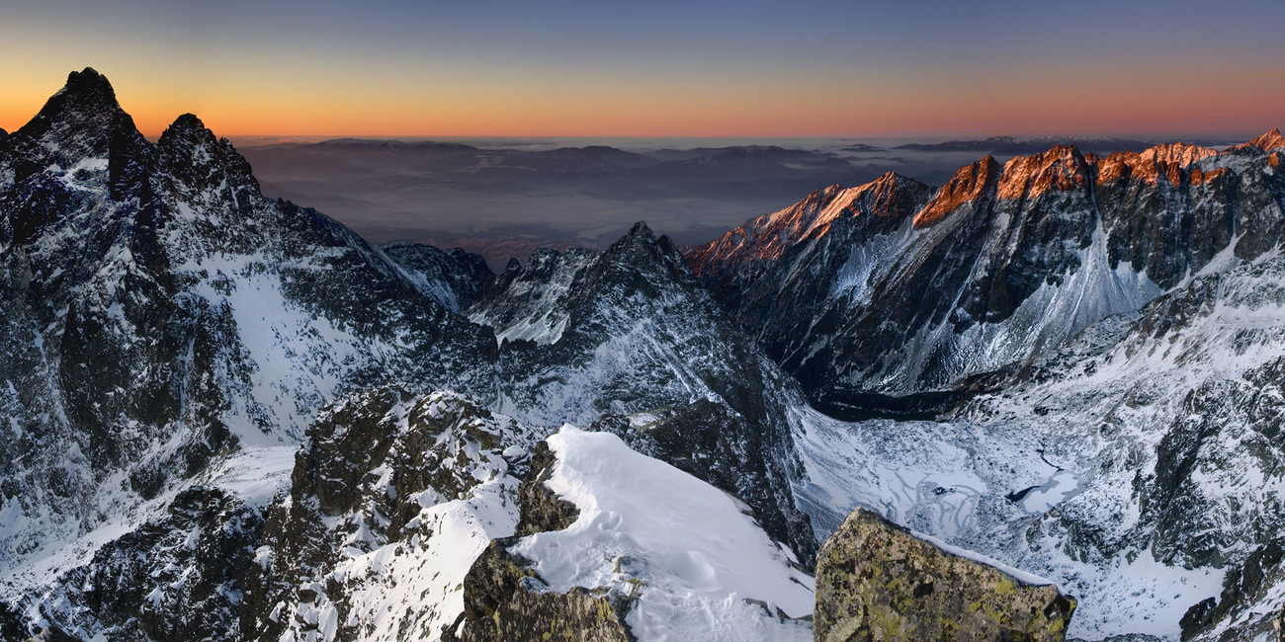
Presentation Title
Tatra National Park
Lenka Toporová & Matej Pošefko
2.D
Presentation Subtitle Your company information

Slide 2
General information
in North Central Slovakia in Tatra Mountains
east part – Prešov region
protected area of flora and fauna
1949
Unesco Biosphere Reserve (1993)
738 km²
Eastern Tatras – High Tatras, Belianske Tatras
600 km of hiking trails
16 marked bike trails

Slide 3
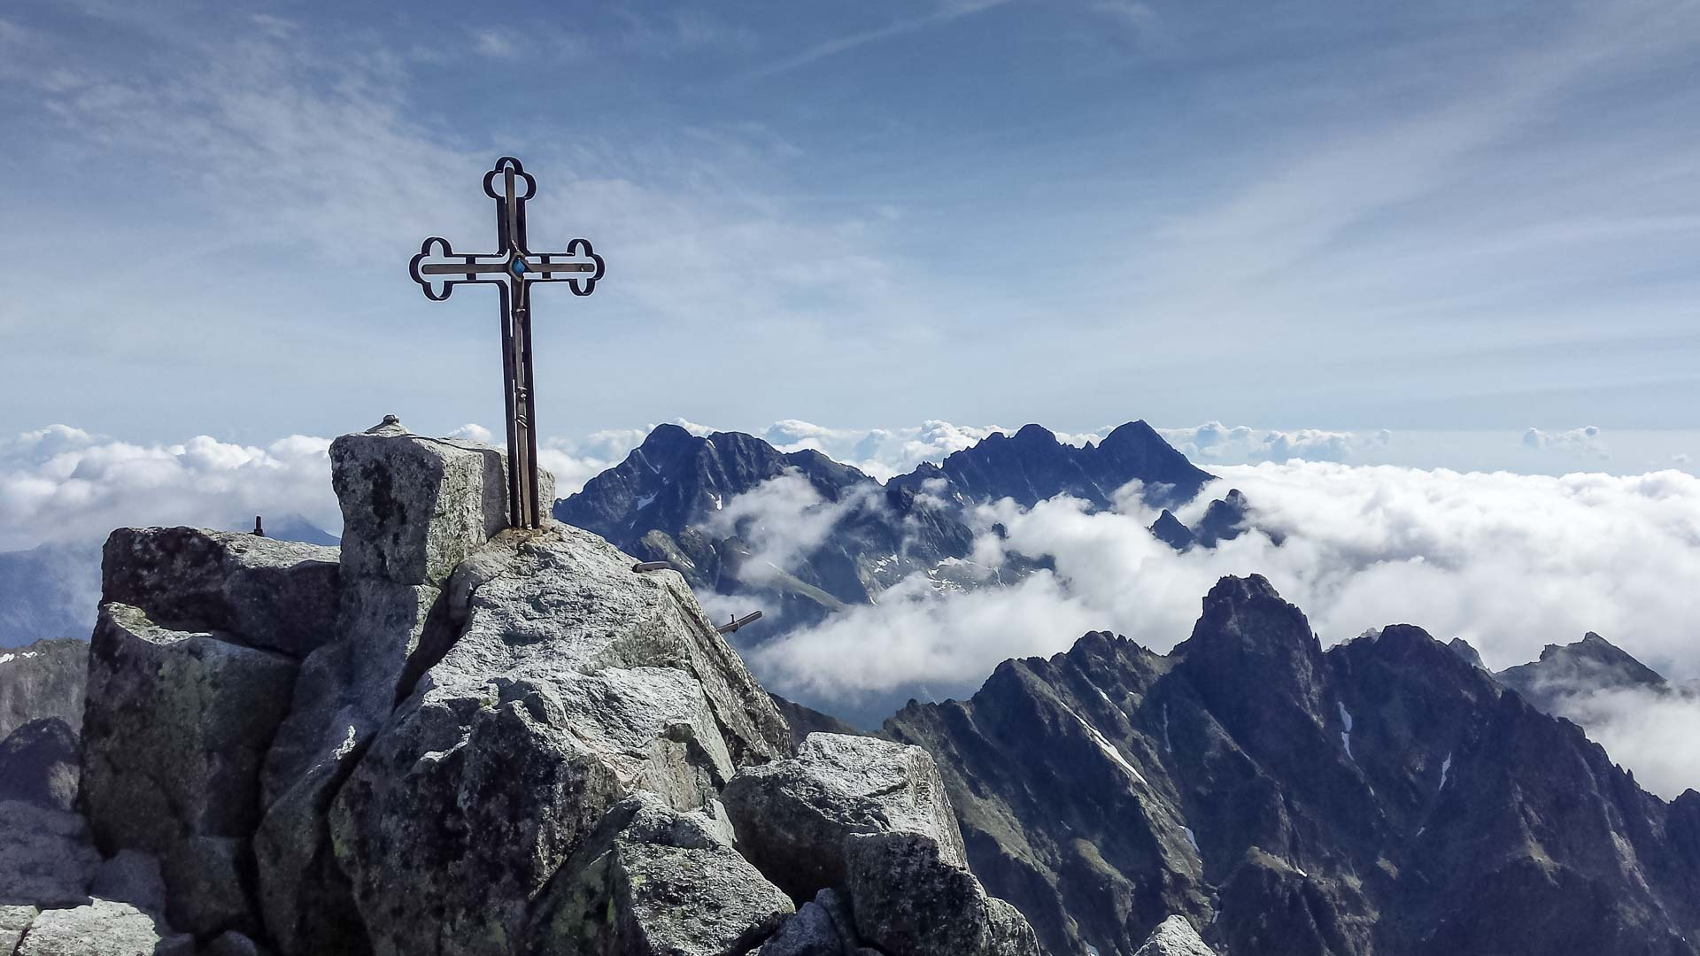
High Tatras
created 60 millions years ago
glacier activity 2 mil. years ago
26 peaks higher than 2500 meters
Gerlachovský štít – 2 655 m

Slide 4
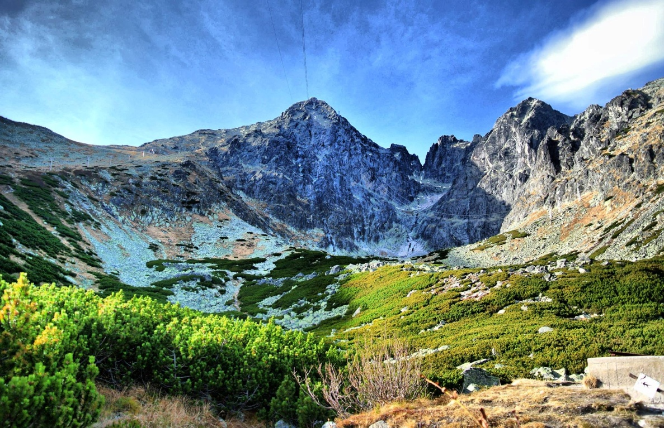
Peaks
Lomnický štít – 2 634 m
Ľadový štít – 2 627 m
Pyšný štít – 2 623 m
Zadný Gerlachovský štít – 2 616 m
Lavínový štít – 2 606 m
Malý Ľadový štít – 2 602 m
Kotlový štít – 2 601 m
Kežmarský štít – 2 556 m
Vysoká – 2 547 m
Rysy – 2 503 m
Kriváň -2494 m

Slide 5
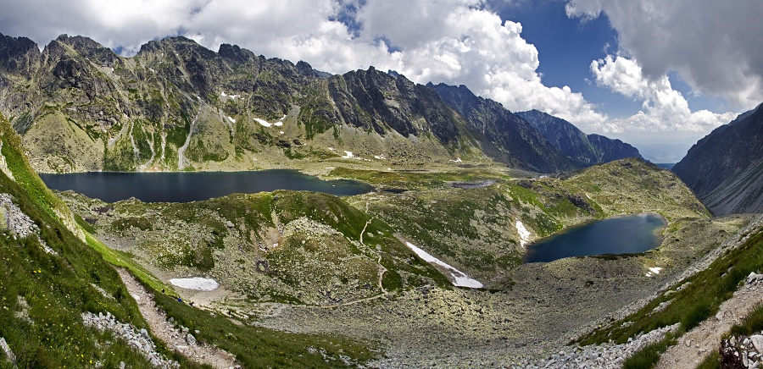
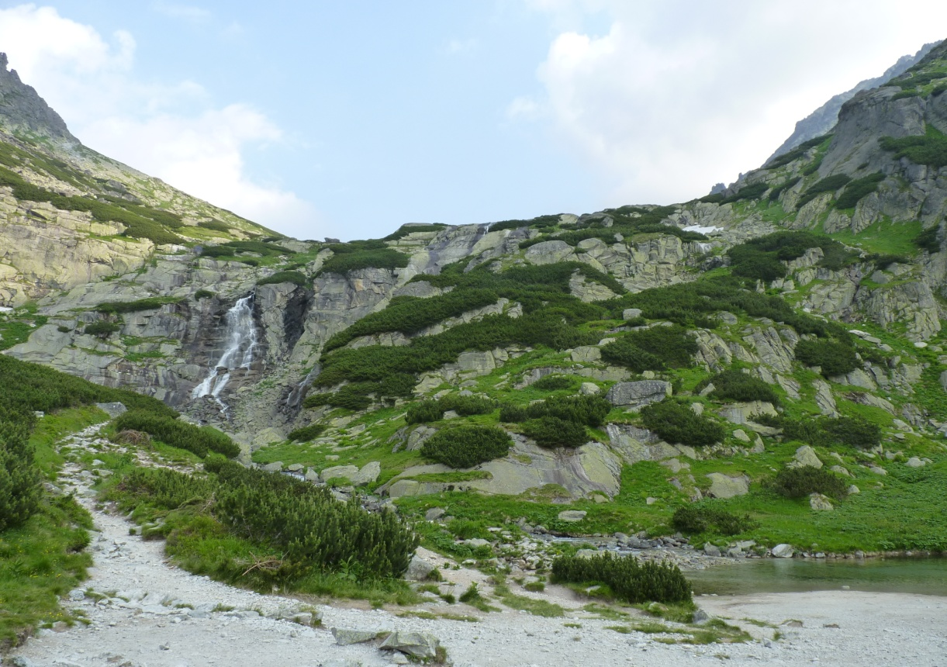
Valleys
Skalnatá
Batizovská
Bielovodská
Furkotská
Javorová
Kôprová
Malá Studená
Mengusovská
Mlynická
Velická
Veľká Studená

Slide 6
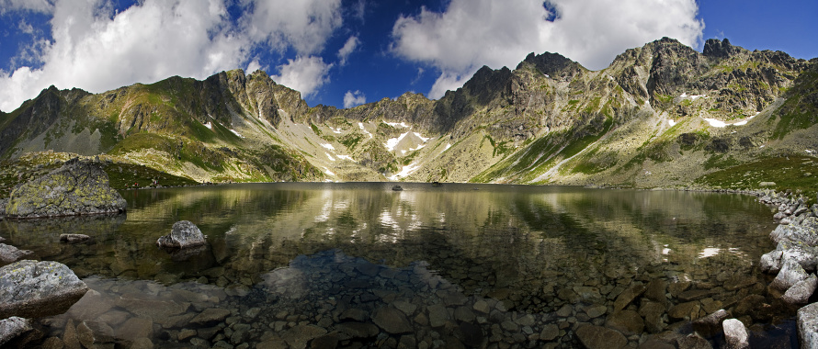
Tarns
more than 80
Veľké Hincovo pleso (20 ha, 53 m)

Slide 7
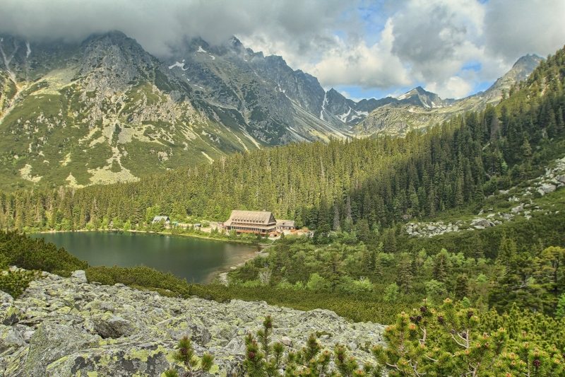
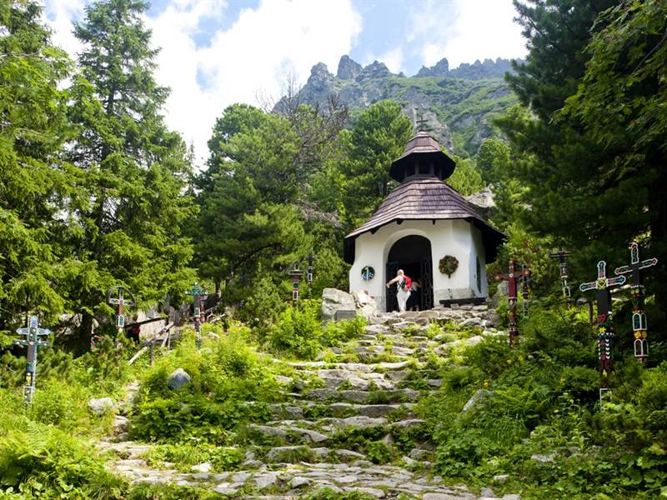
Tarns
Popradské pleso
Symbolic cemetery

Slide 8
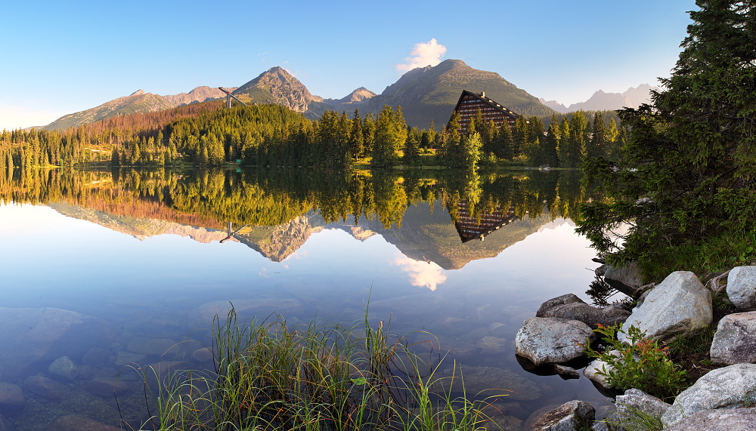
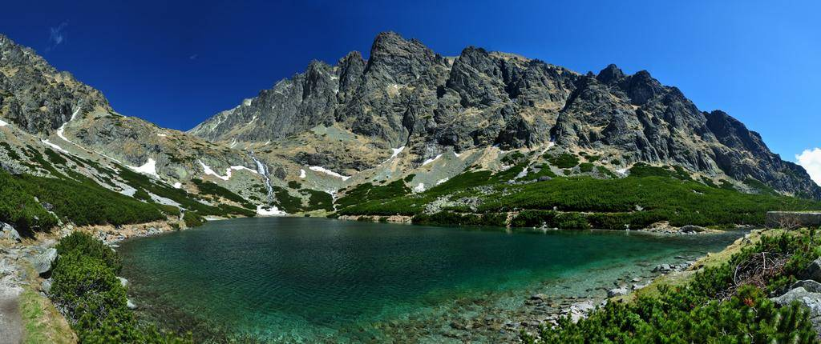
Tarns
Štrbské pleso
Velické pleso

Slide 9
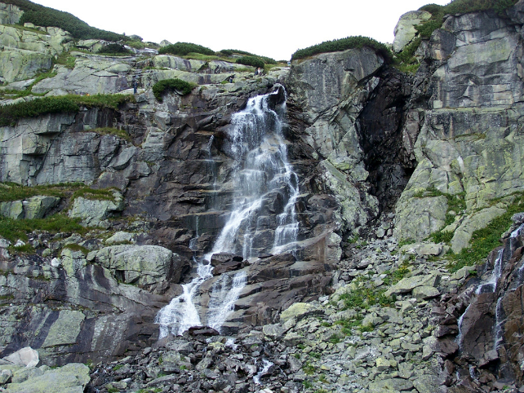
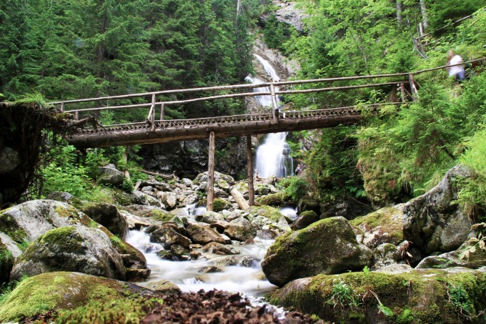
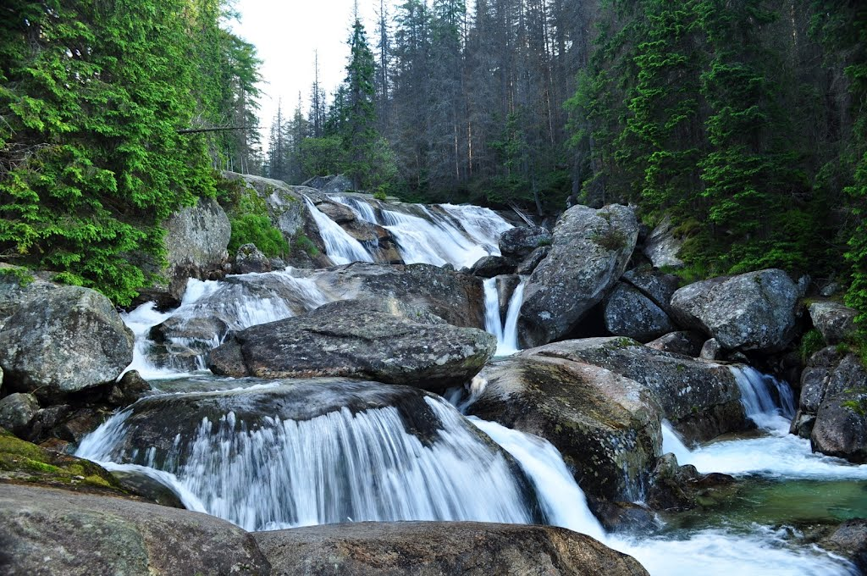
Waterfalls
Kmeťov vodopád – Nefcerka valley – 80 m
Waterfalls of Studený potok
Waterfall Skok

Slide 10
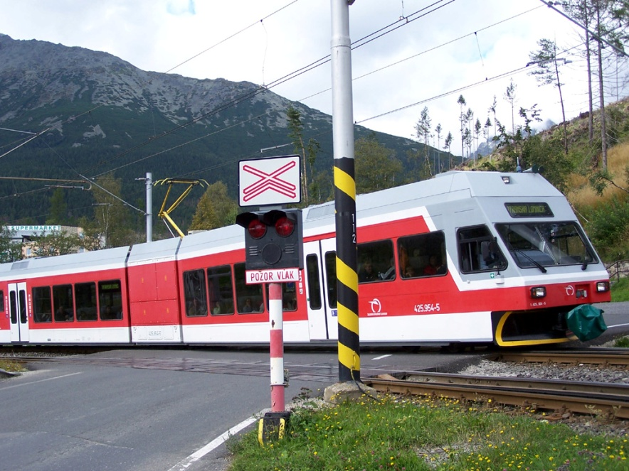
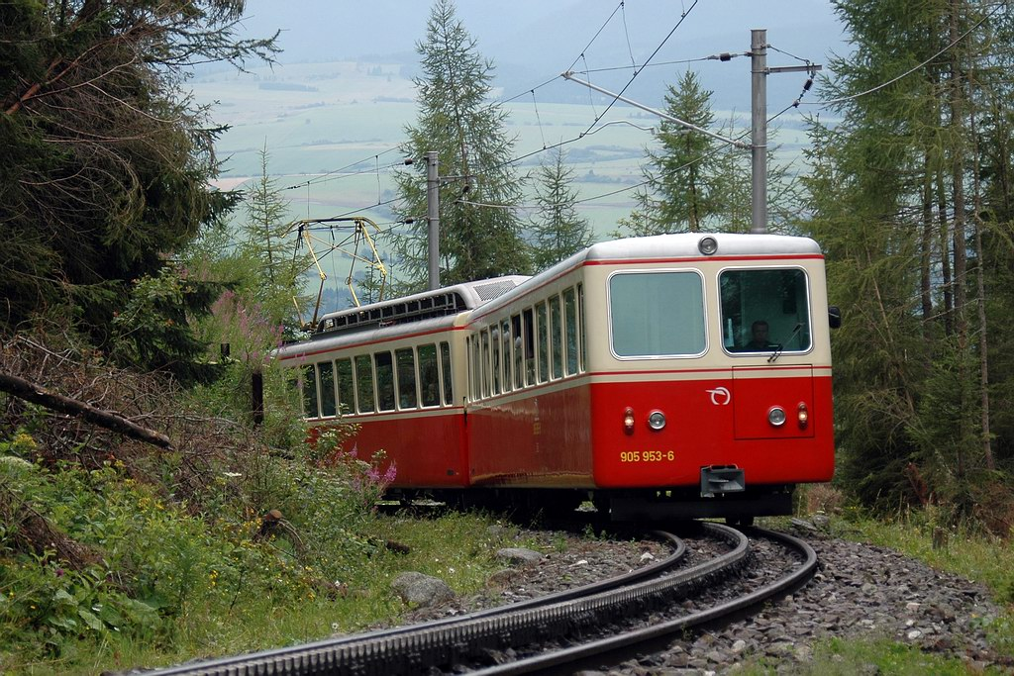
Transport
Tatra electrical railways
Poprad-Tatry – Starý Smokovec – Štrbské Pleso
Starý Smokovec – Tatranská Lomnica
Cog railway
Štrbské pleso – Štrba

Slide 11
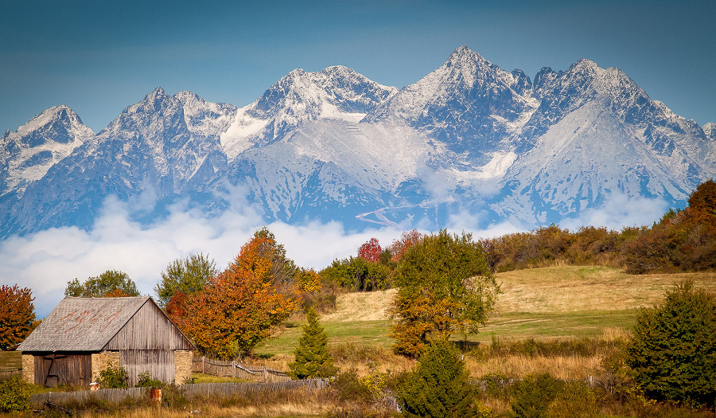
Climate
mountainous, alpine
snow – 180-250 days of the year
up to 300 days per year – windy weather
average temperature 5 °C; 15 °C in July
autumn

Slide 12
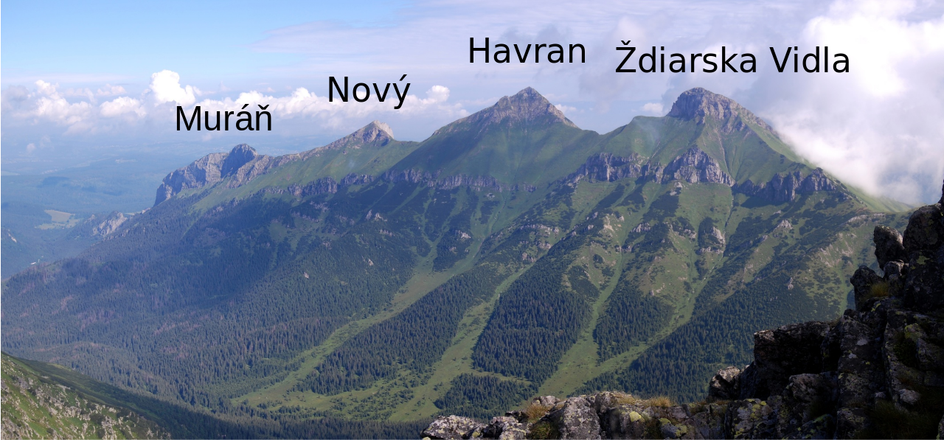
Belianske Tatras
14 km long ridge
not influenced by glacier activity
limestone, dolomite walls
Havran Peak – 2 151 m

Slide 13
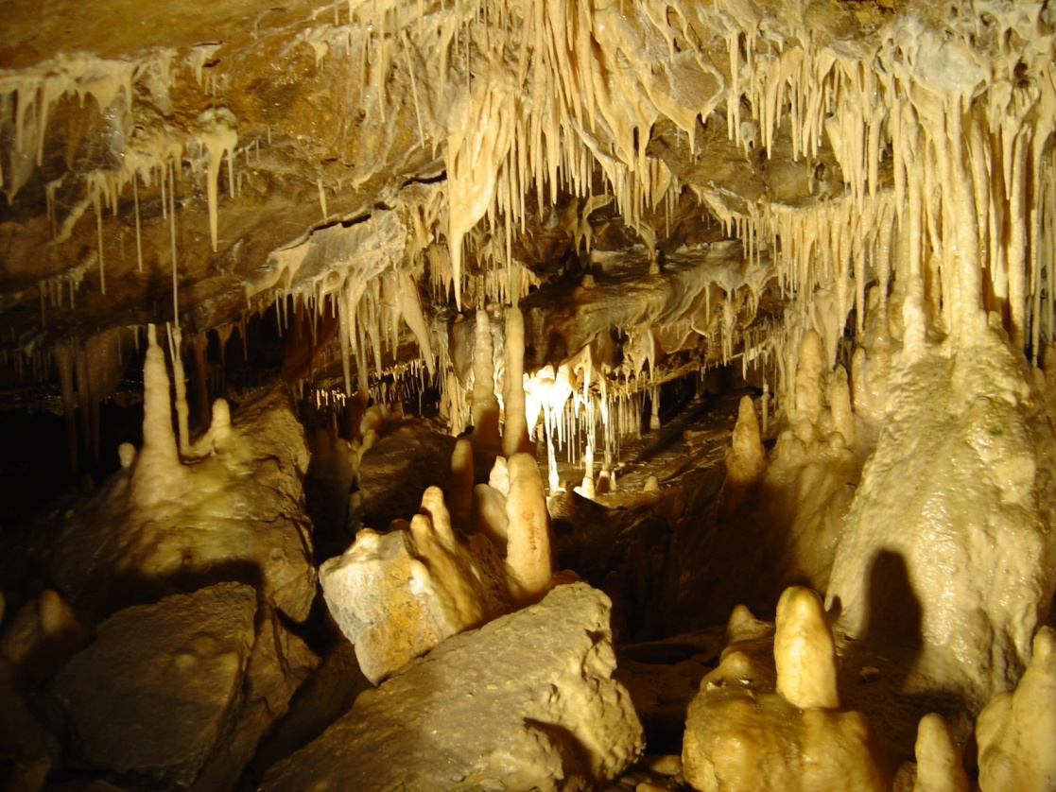
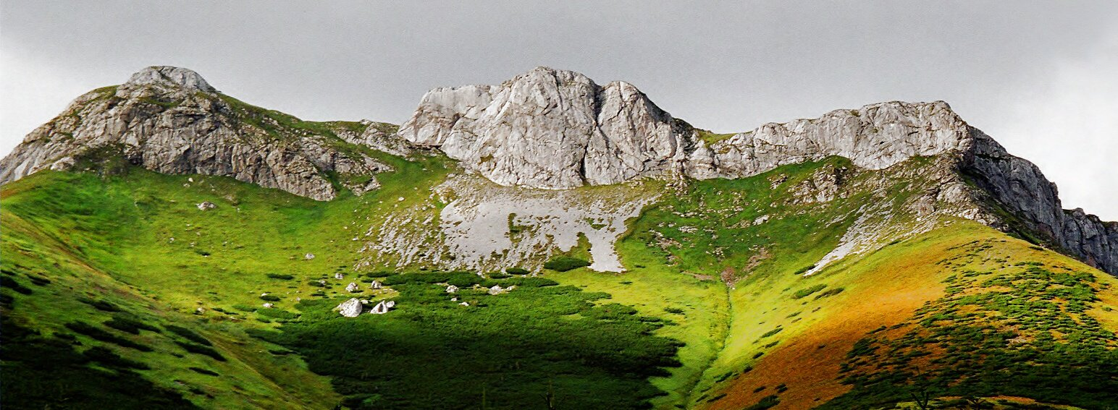
Belianske Tatras
carst area
Belianska cave
chalet Plesnivec
first visitors – 14th century
mining – 17th century
most of the area – closed for public (1978)

Slide 14
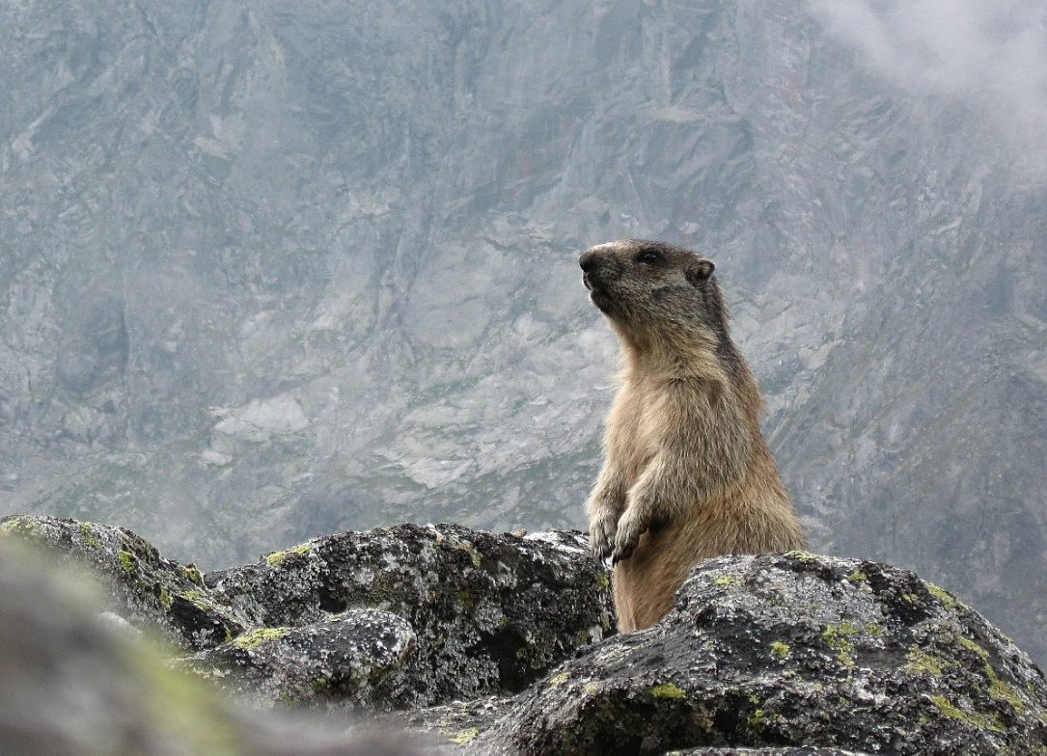
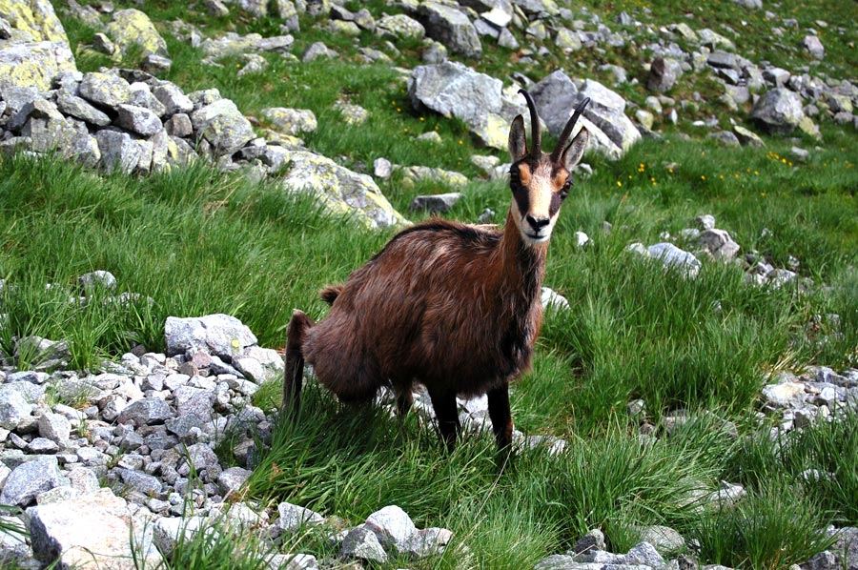
Fauna of TANAP
High Tatras
fox, marten, wild cat, polecat, badger
bears, lynxes, wolf
alpine marmots, golden eagle
Belianske Tatras
Tatra chamois – largest population

Slide 15
Flora of TANAP
Vegetal grades in High Tatras:
The mountain grade (800 - 1550 m) - firs, saffrons, may-flowers, lilies
The subalpine grade (1550 - 1800 m) – dwarf pine, limba-firs, birches, muntain ashes and willows
The alpine grade (1800 - 2300 m) - lichens
The subnival grade (2300 m and more) – lichens, vascular plants - plesnivec alpínsky, poniklec, horec bodkovaný, horec Clusiov, zvonček alpínsky
endemic Tatra scurvy-grass
Belianske Tatras:
Edelweiss (plesnivec alpínsky)

Slide 16
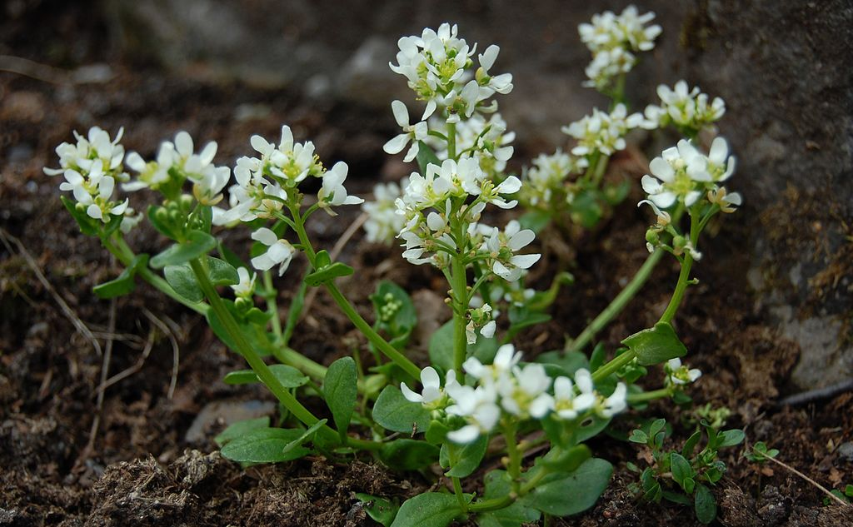
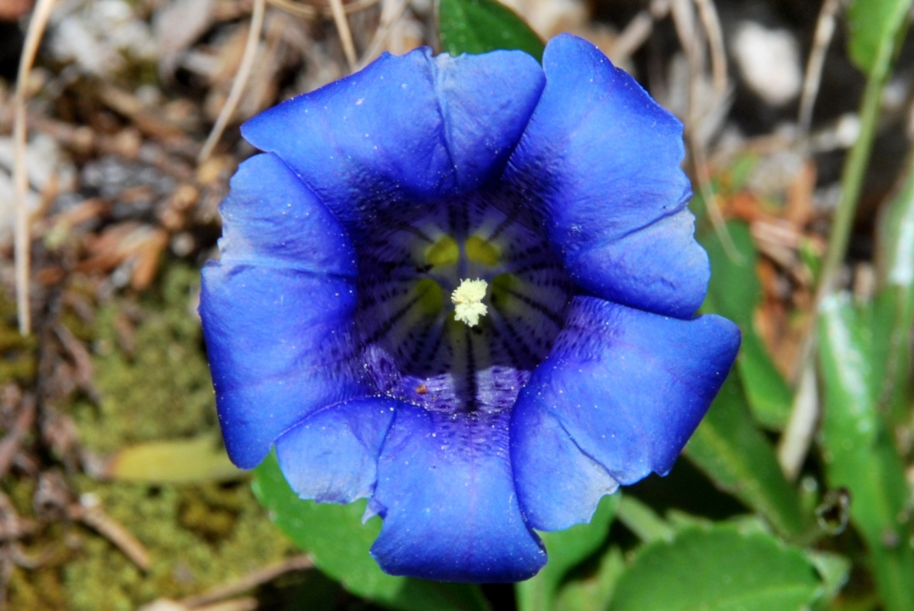
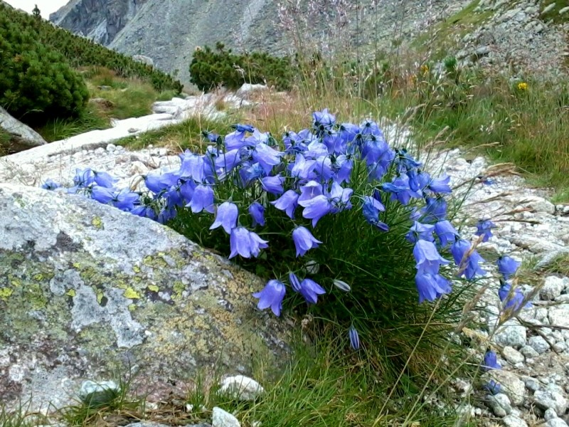
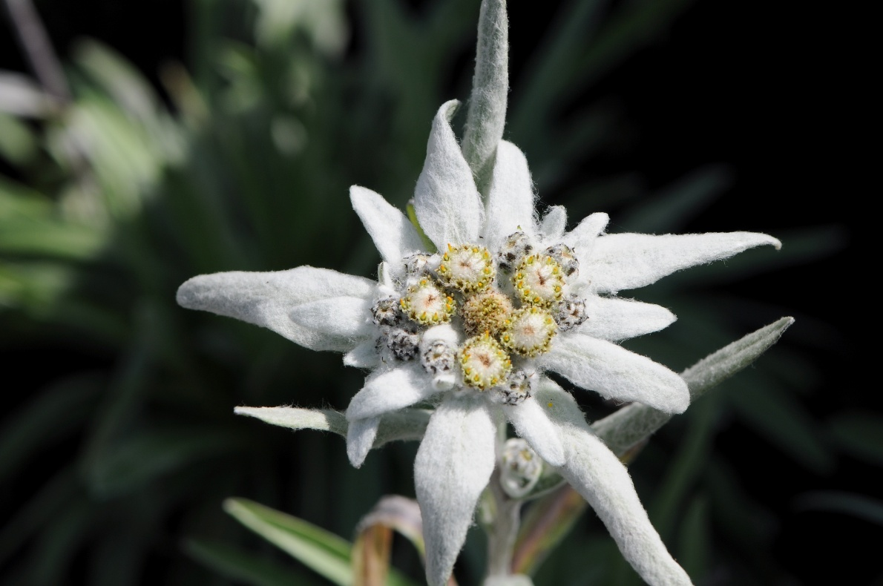

Slide 17
Thank you
for your attention!

Slide 18
Sources
http://slovakia.travel/en/national-park-of-high-tatras
http://www.slovak-republic.org/high-tatras/
http://blog.timeforslovakia.com/5-breathtaking-mountain-lakes-in-high-tatras-slovakia/
http://www.tatry.sk/en/tips-for-trips/natural-beauty/tatra-valleys/
http://www.beliansketatry.com/
https://www.sorger.sk/flora-tatier
https://www.sorger.sk/fauna-tatier

