Slide 1
PARKOUR
Tatiana Čirčová 2.a

Slide 2
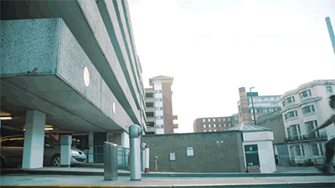
Training discipline with french origins =l’art du déplacement (The art of moving)
Using your body to get from one place to another without any special equipment in the fastest, most effective and most possible way

Slide 3
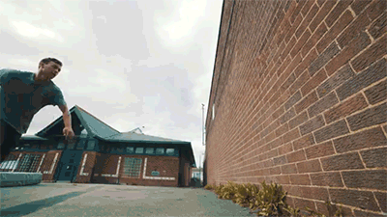
Includes running, jumping, vaulting, climbing, rolling and the most suitable movements for situation
Based on training to improve moves, mind
Connects to martial arts – fastest way to escape

Slide 4
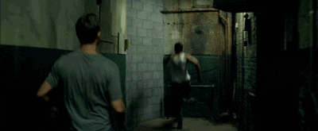
DAD of Parkour – Raymond belle
his son, David belle , extended it more
Person doing parkour – traceur / traceuse
David Belle

Slide 5
sources
http://www.extremesportscompany.com/list-of-extreme-sports.html
https://en.wikipedia.org/wiki/Parkour
https://cs.wikipedia.org/wiki/Parkour
https://www.tumblr.com/search/parkour
https://i.ytimg.com/vi/A_GmrfIKbDg/maxresdefault.jpg
http://giphy.com/gifs/brickmansions-movie-film-r81onBCQjzv7W
https://www.youtube.com/watch?v=NX7QNWEGcNI
https://www.youtube.com/watch?v=ZEs9zmF-Fwk
Thank you for your attention ;)

