Slide 1
SKALTA experiment
SlovaKiAn Large-area Time coincidence Array

Slide 2
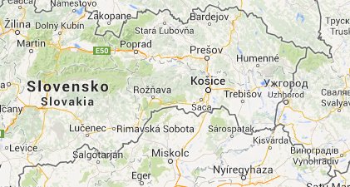
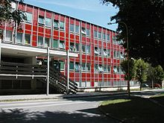
Where? When?
The roof of P. J. Šafárik University in Košice
The experiment is active since June 2010

Slide 3
Purpose
Detection of secondary cosmic rays from a primary particle of energy at least 10¹⁴ eV
Education and motivation for elementary particle physics students
...also, barometric station in the area.

Slide 4
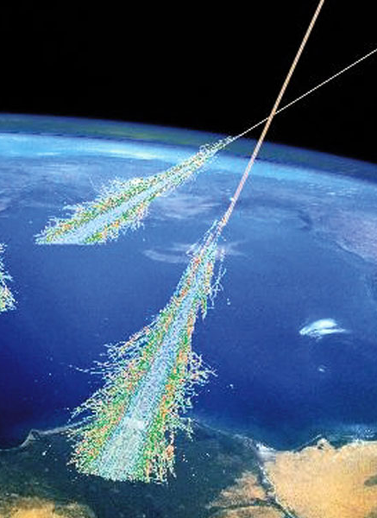
Cosmic rays
High energy particles from outside of the Solar system (or possibly even from outside of the galaxy)
Interaction of primary cosmic rays with Earth’s atmosphere => secondary cosmic rays
Typical particles:
Primary c.r. - protons and α-particles
Secondary c.r. - neutrons, pions, positrons, muons

Slide 5
Contribution of the cosmic rays
Chemical reactions in the atmosphere:
Depletion of ozone
Maintaining the amount of carbon-14 (as well as few other different isotopes)
They are part of the ambient radiation
Considerable effect on electronics (mainly in higher altitude)

Slide 6
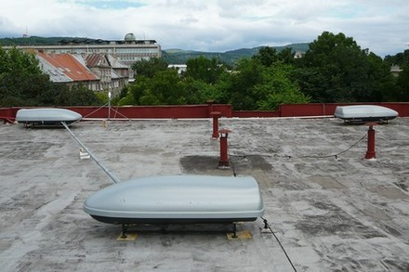
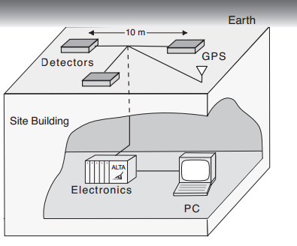
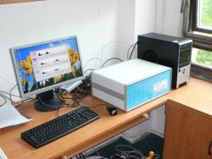
The array
Three detectors
A triangle with side length of 10 m
GPS
Computing station

Slide 7
Legacy of ALTA
It began with ALTA (Alberta Large-area Time-coincidence Array) located in Alberta, Canada
SKALTA is part of huge detector network
Partners:
CZELTA – located in several places throughout the Czech Republic
NALTA – located in Canada, mostly in Edmonton
RoLTA – located in Romania
All the data is now stored at Czech Technical University, Prague, Czech Republic

Slide 8
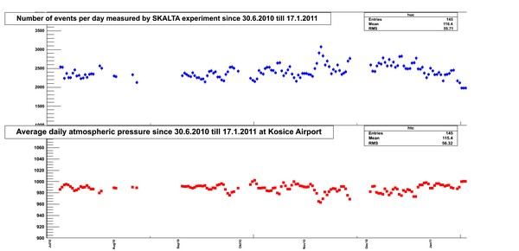
ROOT Framework
Used for education
Is a preparation for the real analysis framework AliRoot
All the data is available online on the site of the project

Slide 9
Future goals
To install more detectors on the roofs of other university buildings as well as the roofs of several grammar schools
To make possible even for younger students to try such measurements on their own

