Slide 1
OUR DREAM DESTINATIONS
Alexandra Liptáková
Laura Ivanová
1.A

Slide 2
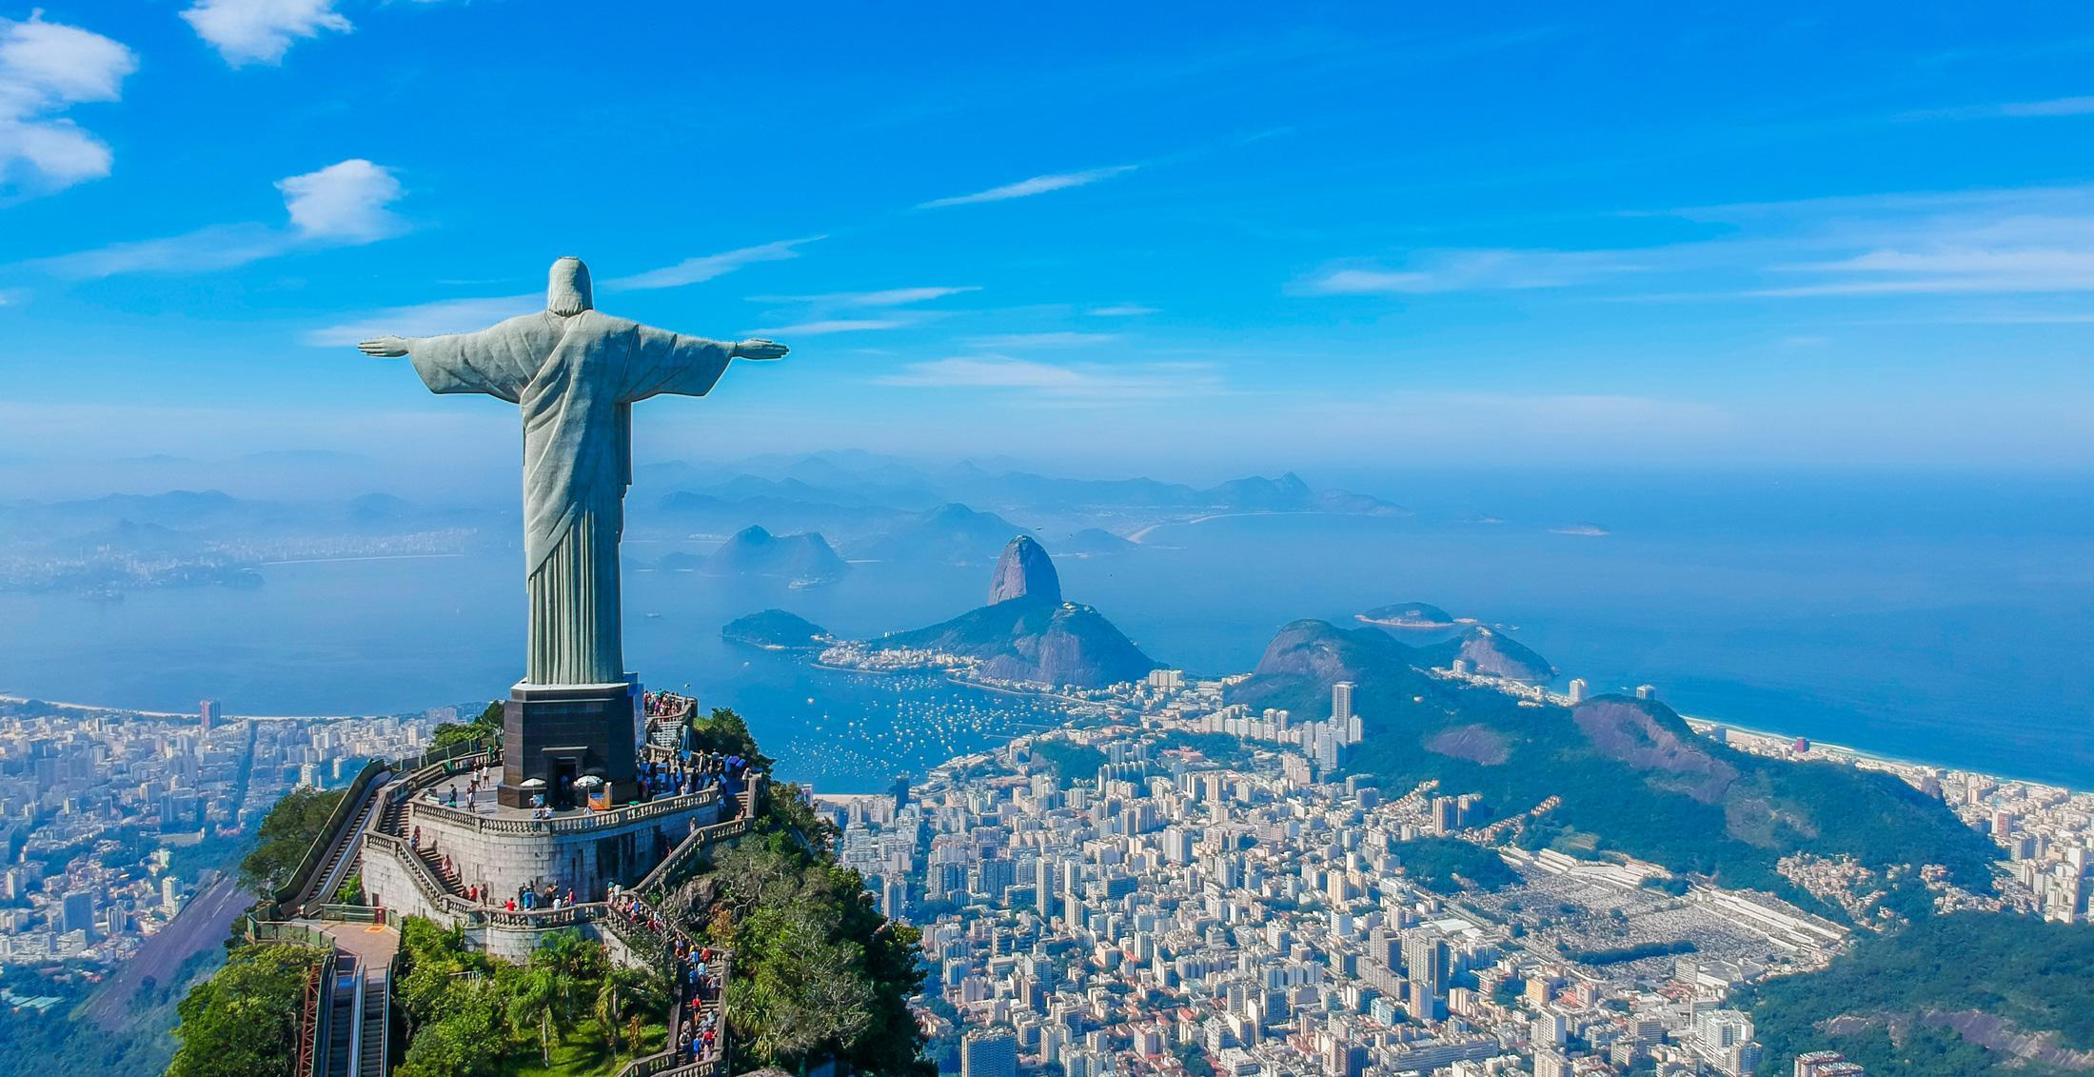
RIO DE JANEIRO

Slide 3
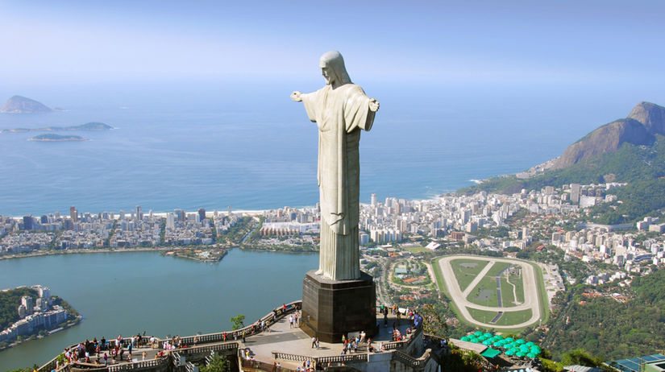
RIO DE JANEIRO
CHRIST THE REDEEMER
38 m
9 years
the original sketch was different - Christ with the ball
new wonder of the world

Slide 4
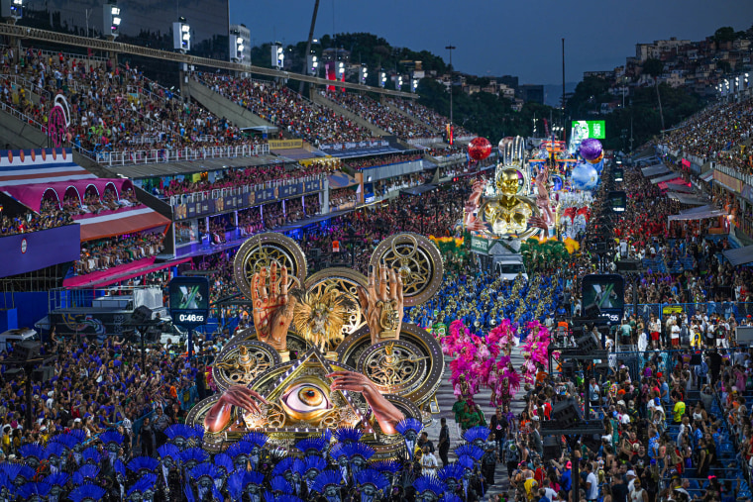
RIO DE JANEIRO
RIO CARNIVAL
1723
school of samba
blocos
history: from day of indulgence to week-long festival of fun

Slide 5
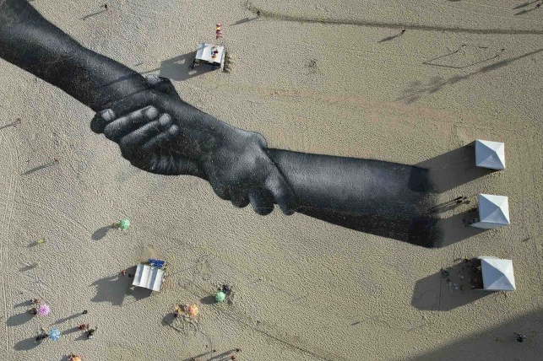
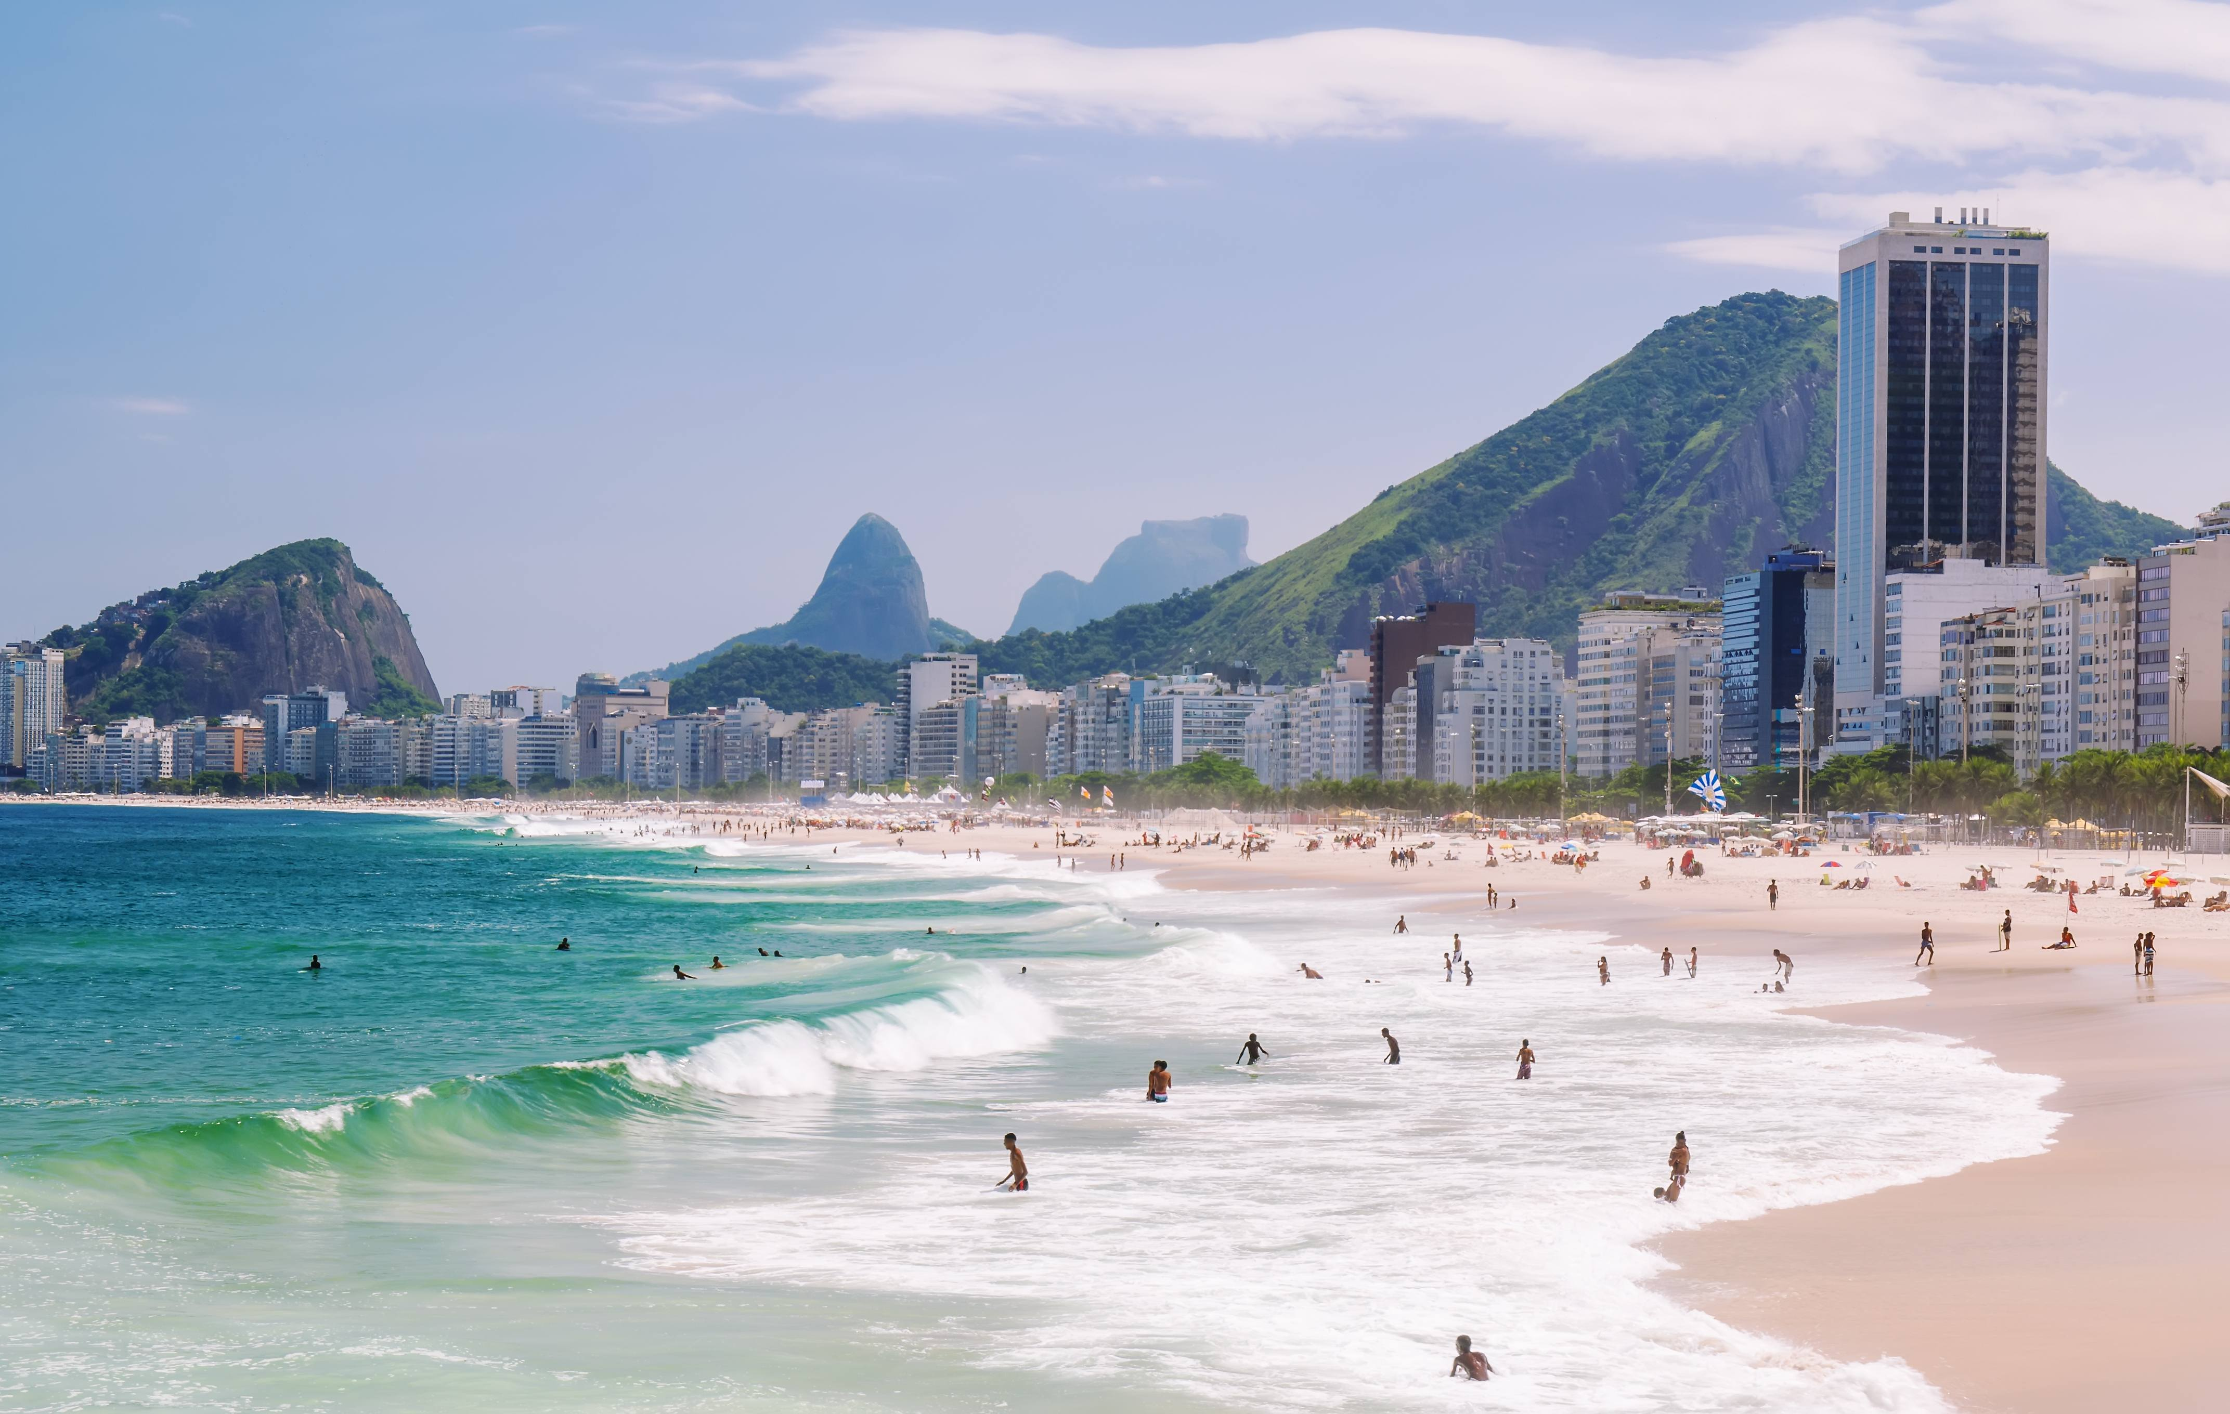
RIO DE JANEIRO
COPACABANA BEACH
2,5 miles
big waves
Military Museum
symbol of togetherness

Slide 6
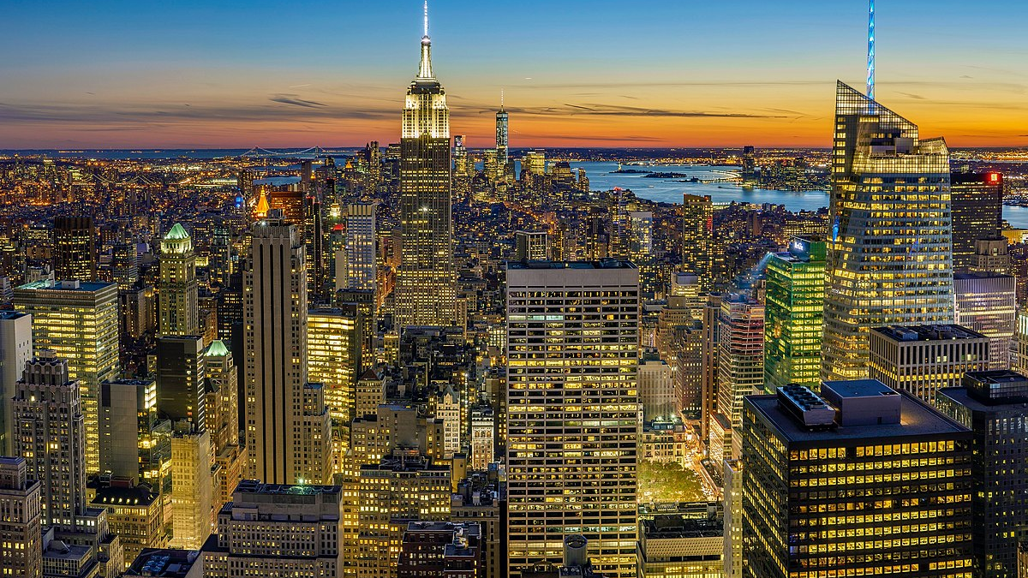
NEW YORK

Slide 7
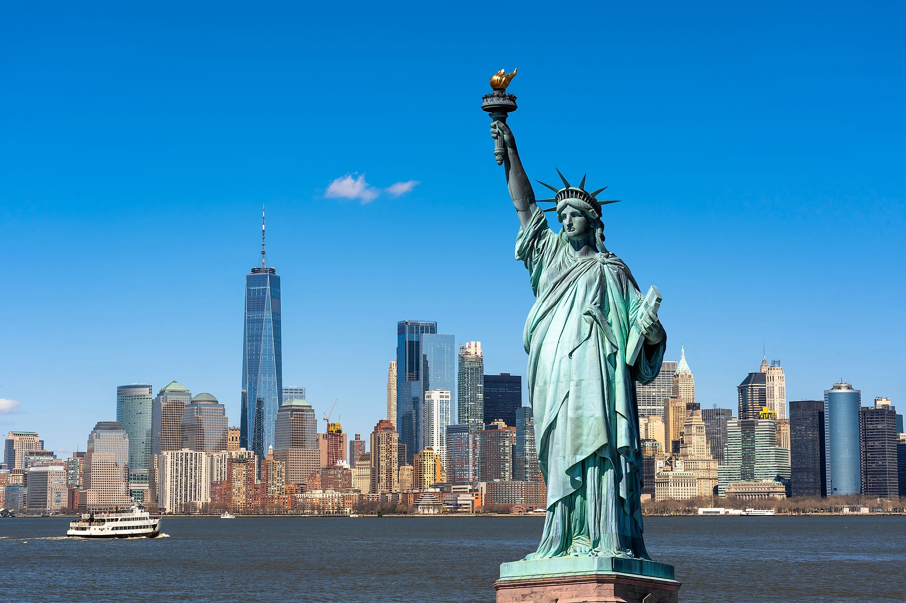
NEW YORK
STATUE OF LIBERTY
93 m
207 t
UNESCO
lighthouse
600 lightning bolts

Slide 8
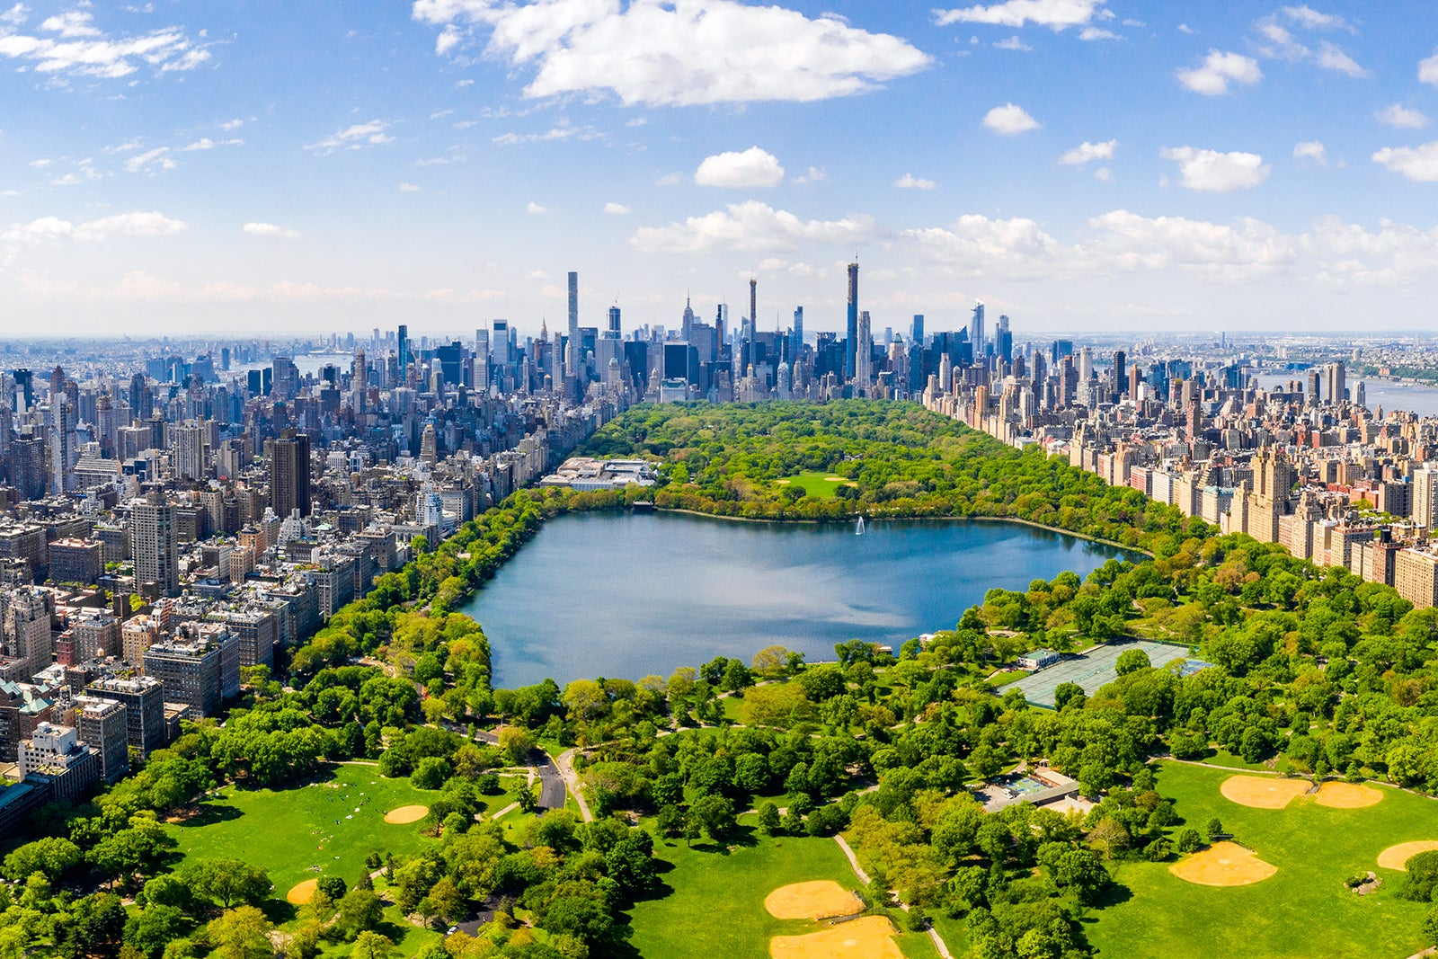
NEW YORK
CENTRAL PARK
ZOO
the oldest public park
filming location
14% are first-time visitors
Victorian Gothic Castle
adopt a bench
bigger than Monaco

Slide 9
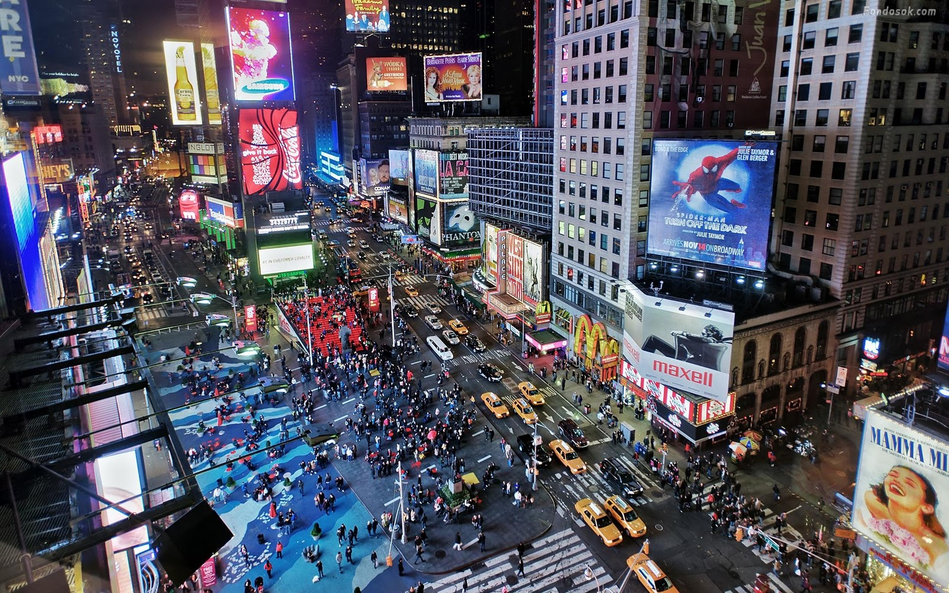
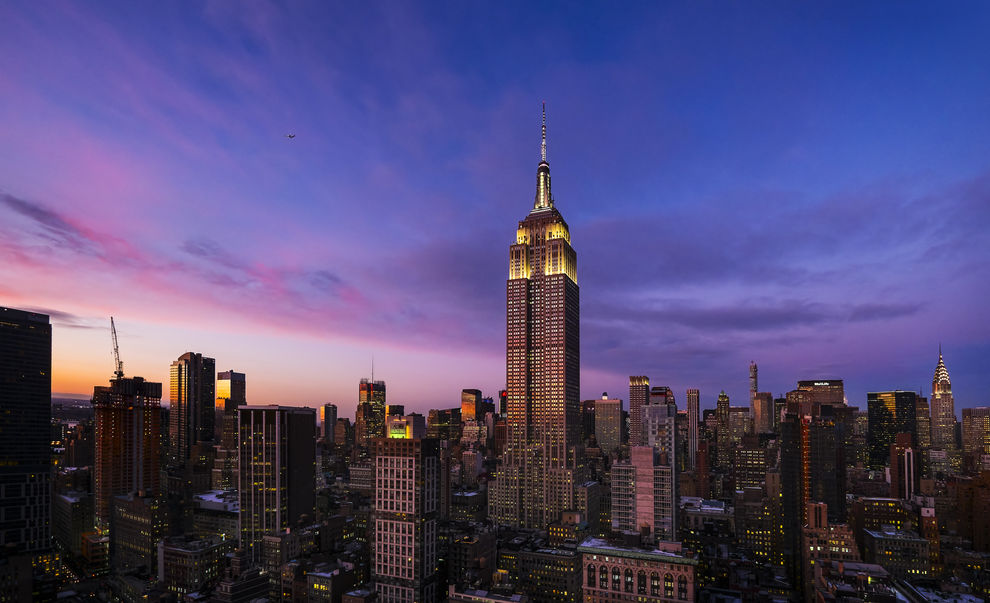
NEW YORK
TIMES SQUARE
can be seen from outer space
500 movies
EMPIRE STATE BUILDING
381m
102 floors

Slide 10
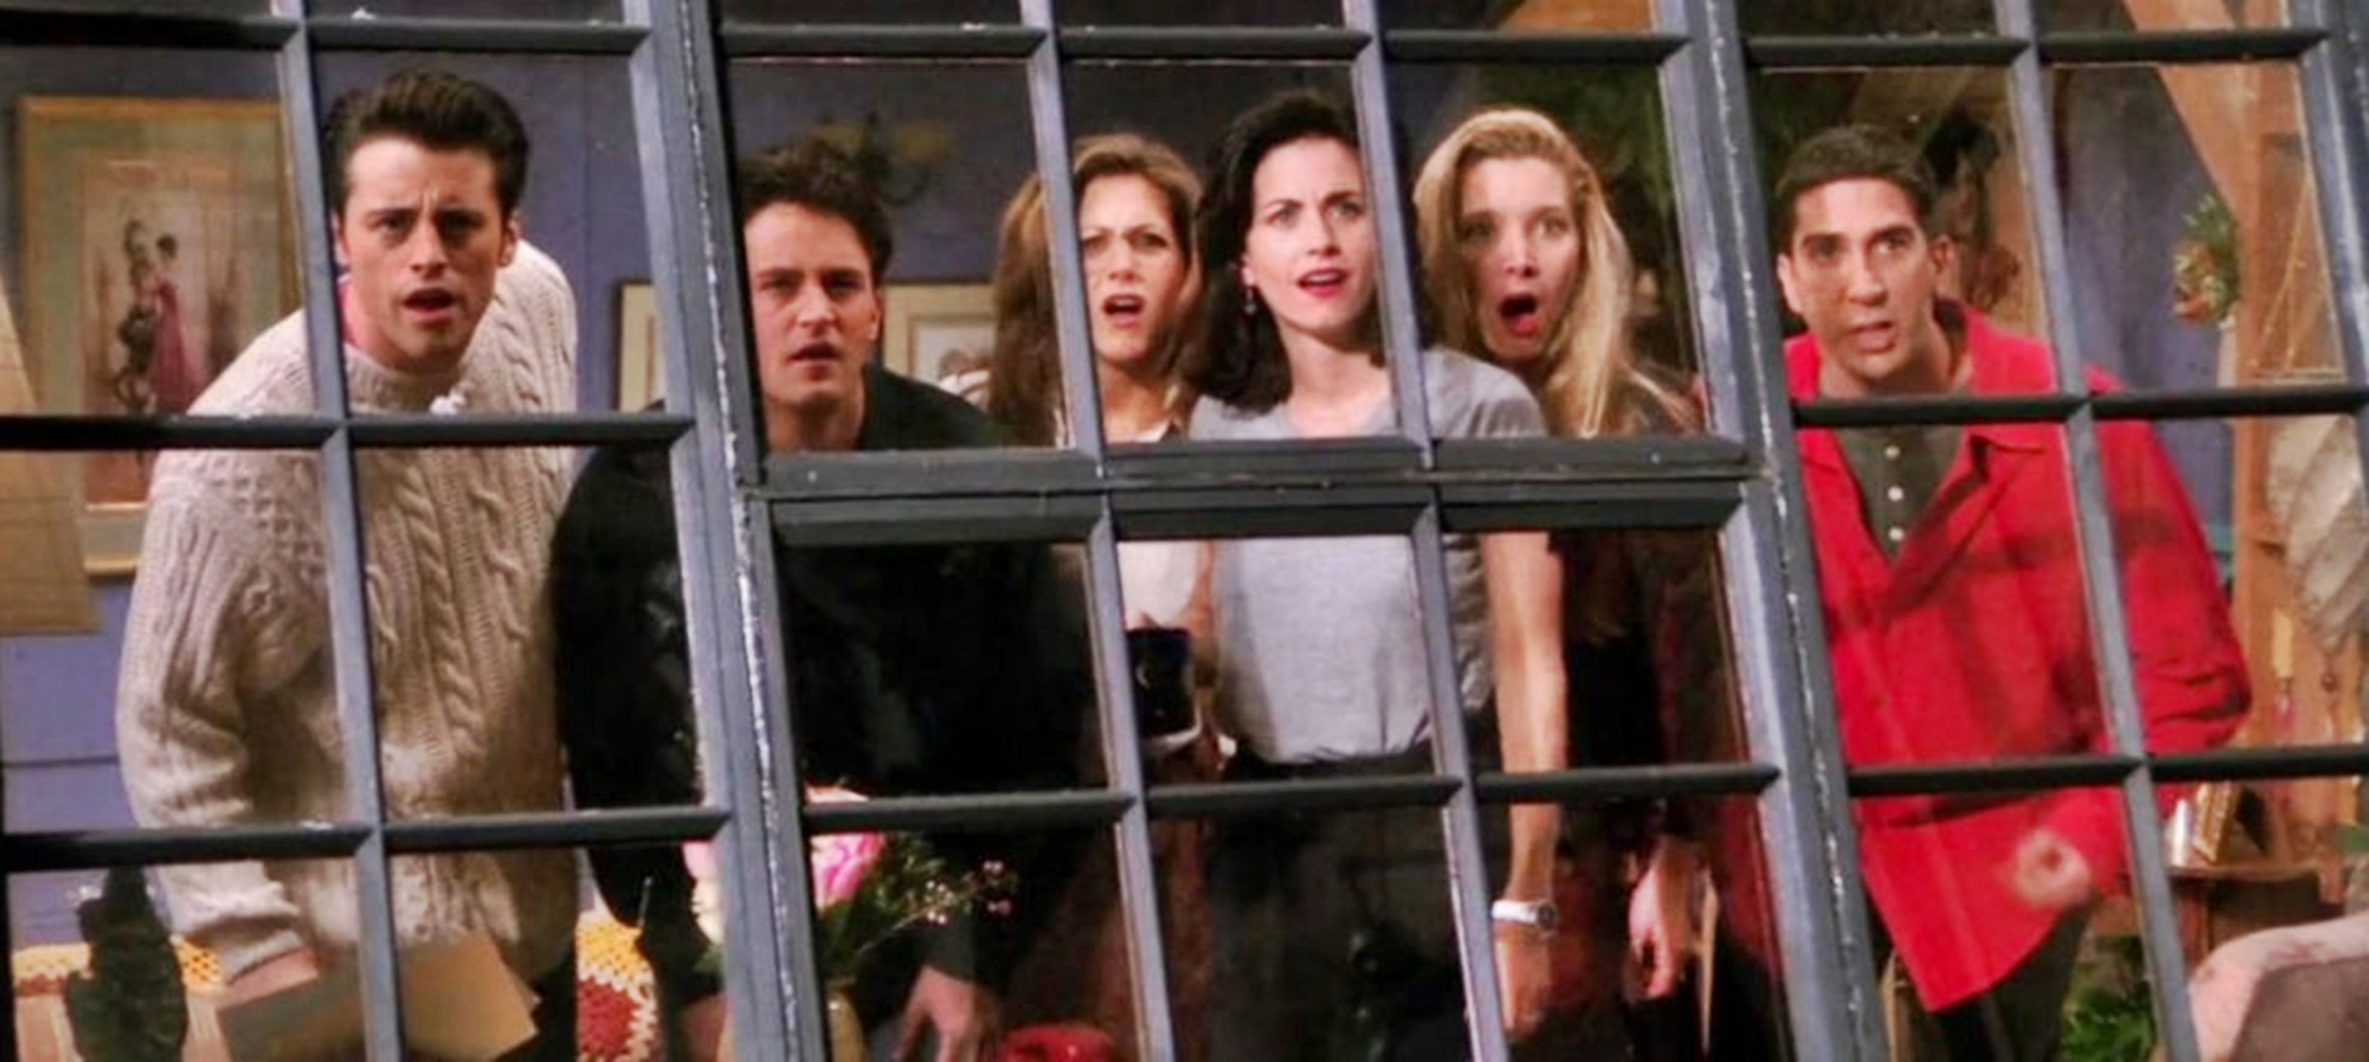
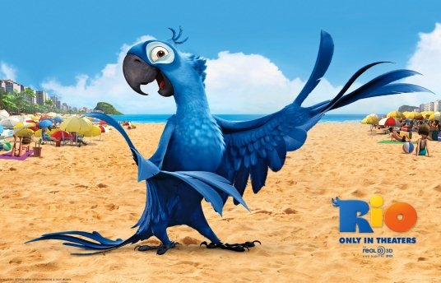
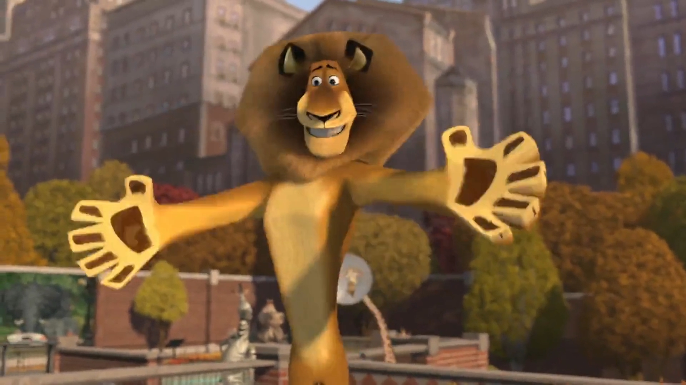
THANK YOU FOR PAYING ATTENTION!

