Slide 1
Traveling
Eva Havírová 1.B

Slide 2
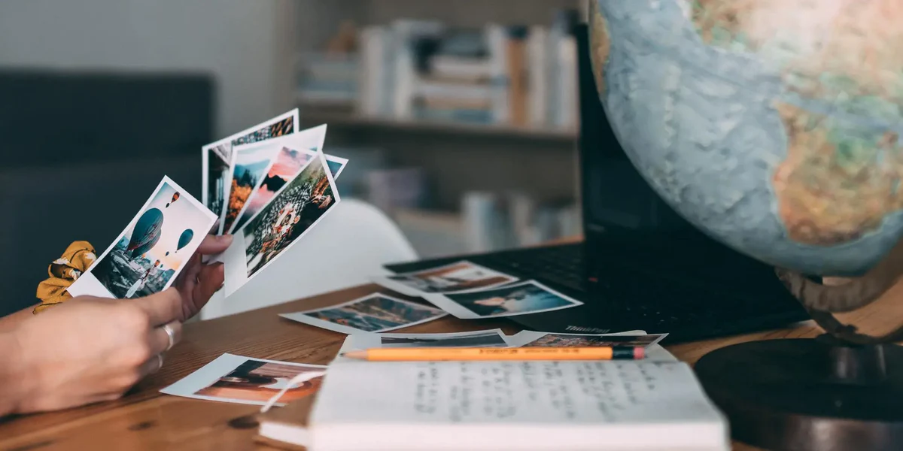
Why should we travel ?
Create experiences – While traveling we can meet new people and experience situations that we would not experience in usual life.

Slide 3
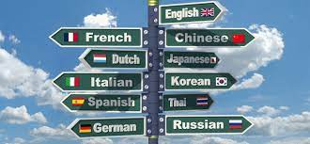
Why should we travel ?
Expand your knowledge – Traveling is the form of education . We can learn about the local culture or learn new languages.

Slide 4
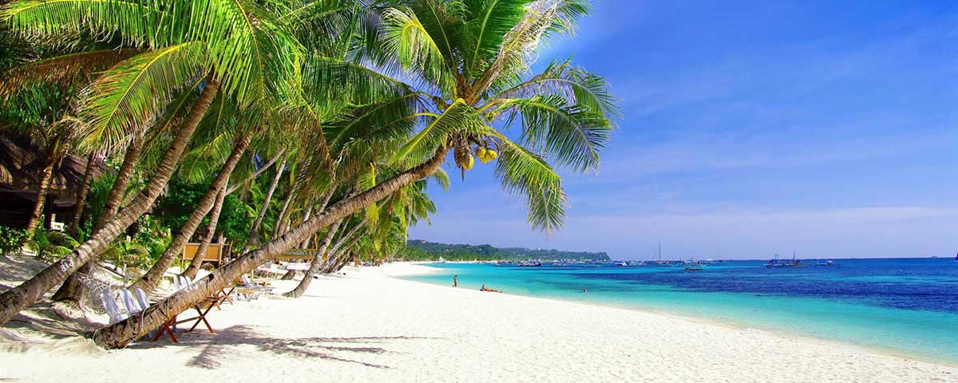
Why should we travel?
Relax – Traveling can help us to reduce stress and break from everyday routine.
Finding yourself – Traveling can be a wonderful way to discover and understand more about ourselves.

Slide 5
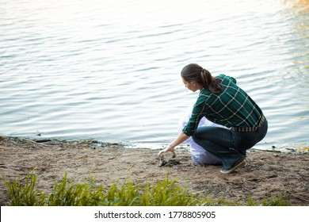
Why should we travel ?
Taking care of our planet - Traveling help us love and protect nature but we should travel in ways that do not hurt the Earth.

Slide 6
Why should we travel ?
Food exploration – Traveling gives us the opportunity to experience different culinary traditions and flavors from around the world.

Slide 7
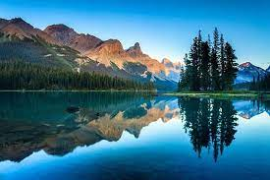
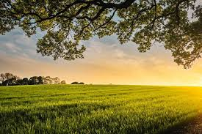
Why should we travel ?
Nature and beauty -The world is full of natural wonders. Traveling gives us chance to discover and admire the beauty of nature .

Slide 8
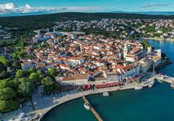
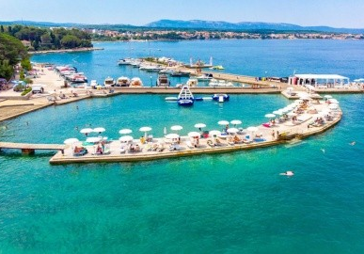
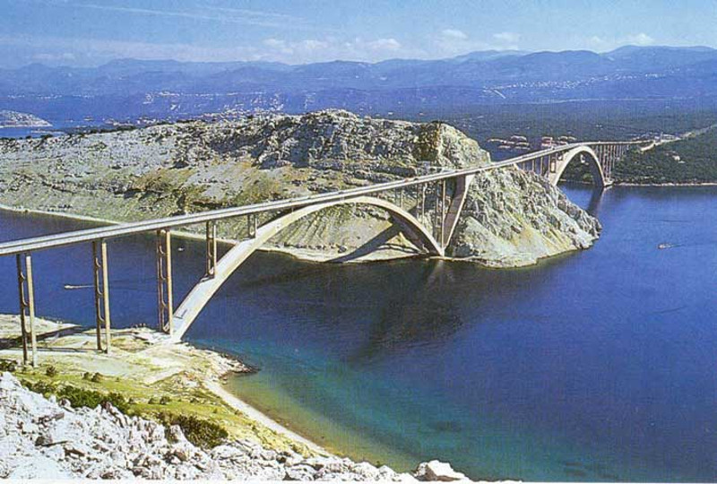
Krk – island in Croatia
One of the largest Croatian islands
city Krk – historical center
The island is connected to the mainland by the bridge

Slide 9
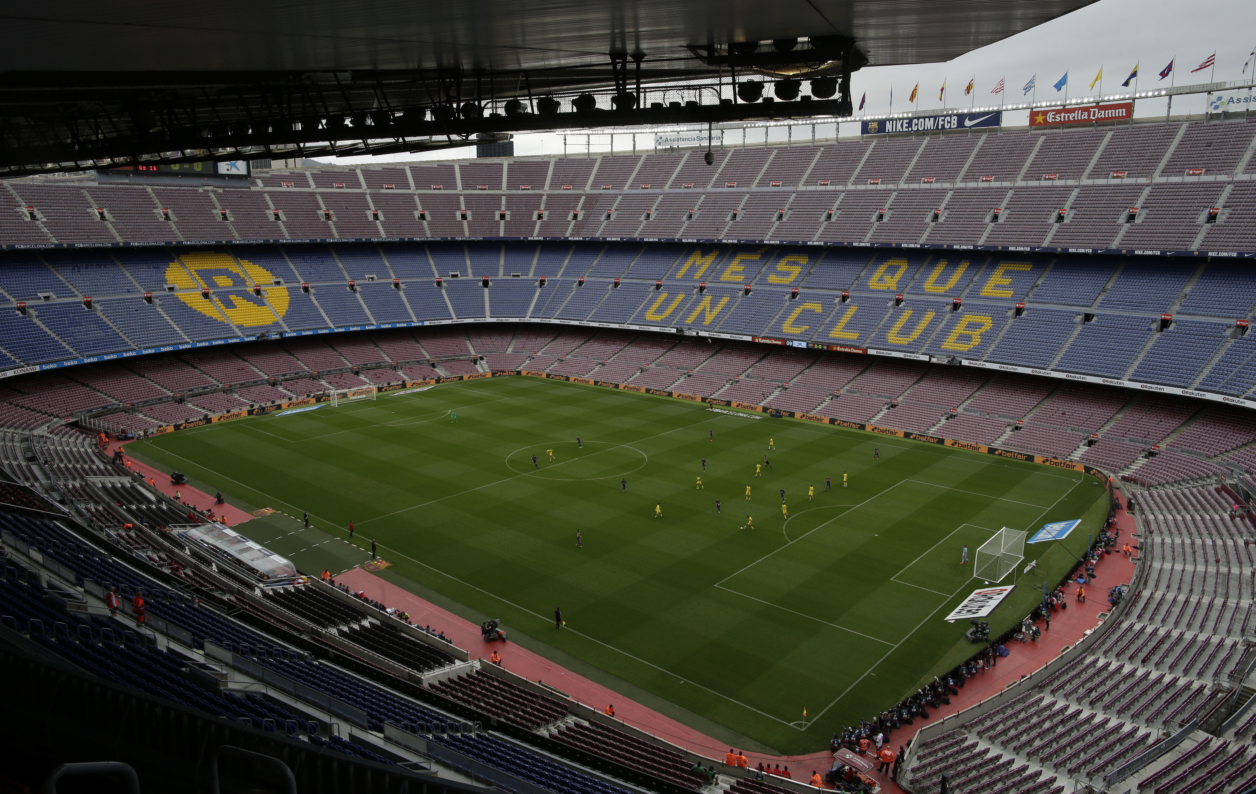
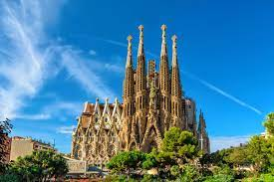
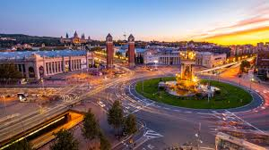
Barcelona
Church Sagrada Familia
Football stadium Camp Nou

Slide 10
Thanks for your attention.

